Slide 1
Overview of Parallel Programming in C++
Pablo Halpern <pablo.g.halpern@intel.com>
Parallel Programming Languages Architect
Intel Corporation
CppCon, 8 September 2014
This work by Pablo Halpern is licensed under a Creative Commons Attribution 4.0 International License.

Slide 2
Questions to be answered
What is parallel programming and why should I use it?
How is parallelism different from concurrency?
What are the basic tools for writing parallel programs in C++?
What kinds of problems should I expect?

Slide 3
What and Why?

Slide 4
What is parallelism?
Parallel lines in geometry:
Parallel tasks in programming:
lines don’t touch
tasks don’t interact
Notes:
In geometry: Parallel lines – going in the same direction but not meeting.
In computation: Parallel tasks – working towards a common goal with minimal interaction.
Interaction DOES happen at the join point, however, which is the root of certain challenges.

Slide 5
Why go parallel?
Parallel programming is needed to efficiently exploit today’s multicore hardware:
  Increase throughput
  Reduce latency
  Reduce power consumption
But why did it become necessary?

Slide 6
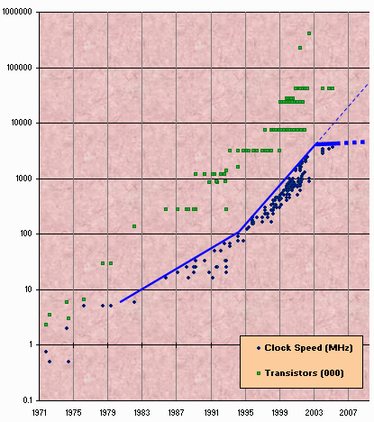

Moore’s Law
Transistor count is still rising, …
Intel CPU Introductions
but clock speed tops out at ~5GHz.
Source: Herb Sutter, “The free lunch is over: a fundamental turn toward concurrency in software,” Dr. Dobb's Journal, 30(3), March 2005.
Notes:
Moore’s law continues to increase transistor count, but clock speed has topped out. To understand why, see next slide.

Slide 7

The single-core power/heat wall
Source: Patrick Gelsinger,
Intel Developer’s Forum,
Intel Corp., 2004
Sun’s Surface
10,000
1,000
100
10
1
Rocket Nozzle
Nuclear Reactor
Power Density
(W/cm²)
If trend had continued
Hot Plate
8086
Pentium®
line
4004
486
8085
386
1970 1980 1990 2000
Year
Notes:
As transistor density and clock speed increased in the late 1990s and early 2000s, power density started going up quickly.
Note that the vertical scale is logarithmic, so the power density went up 10x in that 10-year period.
If the trend had continued, the power requirements and heat-dissipation requirements would have become unsustainable.
The problem was compounded by demands of battery powered/low heat devices like laptops, fanless tablets, and phones.
Today, even supercomputer manufacturers worry more about performance/W than performance alone.
Advances in instruction-level parallelism also slowed down over this period.

Slide 8
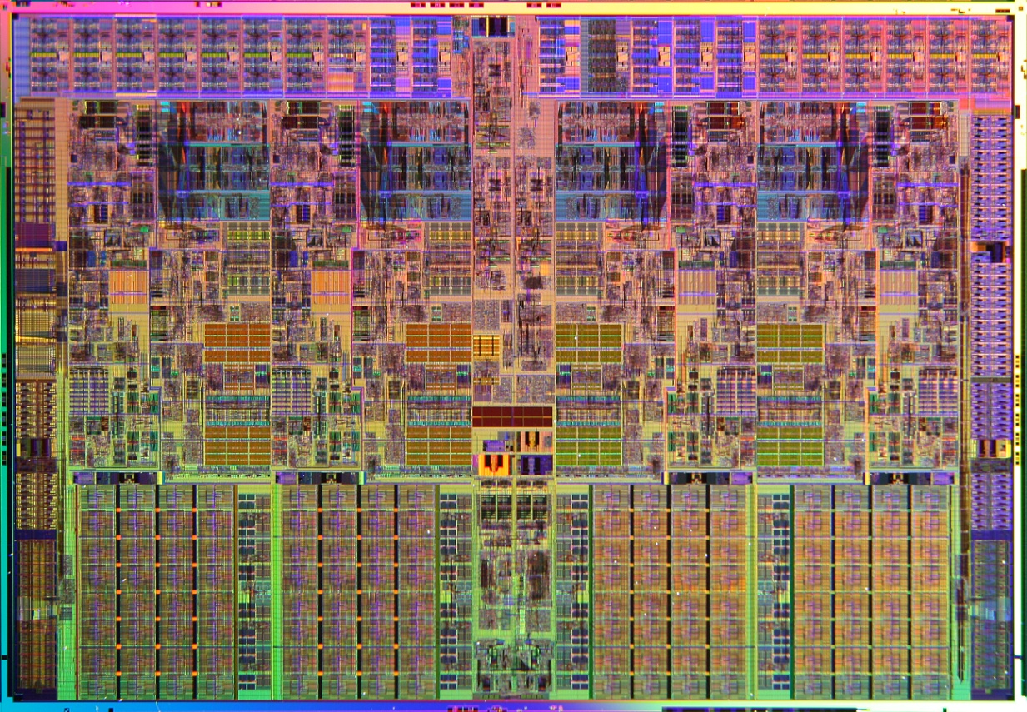
Vendor solution: Multicore
Intel Core i7 processor
2 cores running at 2.5 GHz use less power and generate less heat than 1 Core at 5 GHz for the same GFLOPS.
4 cores are even better.
Notes:
Each generation of Moore’s law increases the number of transistors that can be put on a single die, some of which can be used to increase core count.
Intel’s Xeon E7 series (Ive Bridge EX) has up to 15 cores and Xeon Phi has 57 – 61 cores with 4x hyperthreading (up to 244 hardware threads).
Total processing power increases with each generation, but requires parallel programming to use efficiently.

Slide 9
Concurrency and Parallelism

Slide 10
Concurrency and parallelism:
They’re not the same thing!
Concurrency
Parallelism
Why: express component interactions for effective program structure
How: interacting threads that can wait on events or each other
Why: exploit hardware efficiently to scale performance
How: independent tasks that can run simultaneously
A program can have both
Notes:
Concurrency and parallelism have different goals.
Concurrent programming existed before multicore was common (for example, UI threads).
In the absence of concurrency, some programming problems require messy polling and dispatch.
Classic concurrent problems: producer/consumer, separate threads for UI, computation, and I/O.
Classic parallel problems: graphics (pixel processing), array processing.
Concurrency and parallelism can coexist: concurrent threads can employ parallelism. The reverse is not recommended.

Slide 11


Sports analogy
Photo credit André Zehetbauer (CC) BY-SA 2.0
Photo credit JJ Harrison (CC) BY-SA 3.0
Concurrency
Parallelism
Notes:
In Basketball, you need a minimum of two players (opponents) on court at the same time, interacting.
Playing with fewer than five players on a side produces different results.
Interaction amongst the players is KEY.
Each separate agent (thread) must make forward progress.
Other examples: Soccer, Football, Baseball
Work analogy: TV & Movie production, construction work (which also contains parallelism)
In track, opponents do not need to be running at the same time
Runners can theoretically run one-at-a-time, and their times compared – they do not need to make simultaneous forward progress.
The number of simultaneous runners is determined by resources (number of lanes on the track)
Interactions between runners are minimal.
Other examples: Golf, Crew, swimming
Work analogies: Sorting mail, sewing clothes

Slide 12
Basic concepts and vocabulary

Slide 13
Parallelism is a graph-theoretical property of the algorithm
B
C
D
A
E
H
F
G
I
J
K
(Dependencies are opposite control flow, e.g. C depends on B)
A ≺ B and A ≺ F (A precedes B and F)
B ∥ F (B is in parallel with F)
K ≻ G (K succeeds G) and
K ∥ H, K ∥ B and K ∥ C, etc.
Notes:
Note that these relationships say nothing about simultaneous processing – computation could be performed by a single thread or by up to three threads, so long as the precedes and succeeds relationships are obeyed.
Concurrency is hard – coordination, avoidance of deadlock, etc.
Parallelism absent concurrency is conceptually easy --
The trick is to avoid concurrency in parallel code

Slide 14
Types of parallelism
Fork-Join
A
B
C
Vector/SIMD
A
B
C
A
B
C
Pipeline
Notes:
Fork-Join parallelism is probably the most intuitively form. Control forks into two or more independent tasks, then joins again.
Vector parallelism performs similar operations on different data items at one time. SIMD hardware does this in lock-step using less silicon (and less power) than if each lane were a separate CPU.
Pipeline parallelism moves data through stages. Each stage is dependent on completion of the prior stage for a specific data item, but the prior stage can begin work on the next data item simultaneously. A load-balancing scheduler can keep the cores busy even if one stage is much longer than the others, provided there is enough parallelism overall.
Graph parallelism is a generalization of pipeline parallelism but is hard to draw.
GPGPUs utilize specialized hardware to execute a combination of vector parallelism and limited fork-join parallelism.
These paradigms can be combined, i.e., a pipeline can use fork-join within a single stage.

Slide 15
A modest example

Slide 16

The world’s worst Fibonacci algorithm
int fib(int n)
{
A if (n < 2) return n;
B int x = fib(n – 1);
C int y = fib(n – 2);
D return x + y;
}
Dependency-graph analysis:
  A ≺ B and A ≺ C
  B ∥ C
  B ≺ D and C ≺ D
B
A
D
C
Notes:
The fib() function computes the nth Fibonacci number.
The recursive algorithm runs in exponential time and is a terrible way to compute this value, but it makes a great, easy-to-understand example of how to use parallelism.
This version is serial – it will not run in parallel, but the parallelism is inherent in the algorithm.
All that’s left to do is to use some parallelism framework to exploit this parallelism.

Slide 17
Parallelizing fib using Cilk™ Plus
int fib(int n)
{
A if (n < 2) return n;
B int x = cilk_spawn fib(n – 1);
C int y = fib(n – 2);
cilk_sync;
D return x + y;
}
B
A
D
C
Notes:
The cilk_spawn keyword defines a fork point: it gives the runtime permission to continue without waiting for fib(n-1) to complete.
The cilk_sync keyword defines a join point: anything spawned within the same function must complete before proceding.
There is an implicit cilk_sync at the end of every function.
A cilk_spawn is cheap. Only if there are resources to take advantage of the parallelism are significant scheduler overheads seen.
Therefore, it behooves us to express a lot of parallelism in order to get scaling to more cores.

Slide 18
Fibonacci Execution
sync
spawn
fib(4)
fib(3)
fib(2)
fib(2)
fib(1)
fib(1)
fib(0)
fib(1)
fib(0)
int fib(int n)
{
if (n < 2) return n;
int x = cilk_spawn fib(n – 1);
int y = fib(n – 2);
cilk_sync;
return x + y;
}
Notes:
The entire left half of the tree is in parallel with the entire right half of the tree.
Each level of recursion roughly doubles the amount of parallelism.
Key idea for parallelization:
The calculations of fib(n-1) and fib(n-2) can be executed simultaneously without mutual interference.

Slide 19
A more realistic example:
Quicksort
template <typename Iter, typename Cmp>
void par_qsort(Iter begin, Iter end, Cmp comp)
{
typedef typename std::iterator_traits<Iter>::value_type T;
if (begin != end) {
Iter pivot = end - 1; // For simplicity. Should be random.
Iter middle = std::partition(begin, pivot,
[=](const T& v){ return comp(v, *pivot); });
using std::swap;
swap(*pivot, *middle); // move pivot to middle
cilk_spawn par_qsort(begin, middle, comp);
par_qsort(middle+1, end, comp); // exclude pivot
}
} // implicit sync at end of function

Slide 20
Languages and libraries for parallel programming in C++

Slide 21
Parallelism Libraries:
TBB and PPL
Fork-join parallelism
tbb::task_group tg;
tg.run([=]{ par_qsort(begin, middle, comp); });
tg.run([=]{ par_qsort(middle+1, end, comp); });
tg.wait();
tbb::parallel_for(0, n, [&](int i){
f(i);
});
Pipeline parallelism
tbb::parallel_pipeline(16,
make_filter<void, string>(filter::serial, gettoken) &
make_filter<string, rec>(filter::parallel, lookup) &
make_filter<rec, void>(filter::parallel, process));
TBB Only
Graph parallelism
tbb::graph g;
… /* Add nodes */
g.wait_for_all();
Notes:
Threading Building Blocks (TBB), from Intel and Parallel Patterns Library (PPL) from Microsoft are similar template libraries offering portable parallel facilities.
The task_group facility provides generalized fork-join parallelism.
parallel_for provides a special, common form of fork-join parallelism that works like a ‘for’ loop where all iterations are in parallel.
The parallel_pipeline function and pipeline class provide pipeline parallelism (both are in TBB only, not PPL).
The graph class (TBB only) provides general graph parallelism (requires too much code to show on this slide)
There is no facility for vector parallelism in either library.
Both libraries also provide a rich set of thread-safe containers and other classes useful for parallelism (and concurrency).
Libraries are very flexible, but also verbose, and provide limited compile-time error checking.

Slide 22
Parallelism pragmas: OpenMP
Fork-join parallelism
#pragma omp task
par_qsort(begin, middle, comp);
#pragma omp task
par_qsort(middle+1, end, comp);
#pragma omp taskwait
#pragma omp parallel for
for (int i = 0; i < n; ++i)
f(i);
Vector parallelism
#pragma omp simd
for (int i = 0; i < n; ++i)
f(i); // f() could be simd-enabled
Notes:
OpenMP is an established standard from the OpenMP Architecture Review Board (ARB) (Not ISO).
In C++, it is expressed as a set of #pragmas (mostly) and APIs.
It also works in C and Fortran.
Version 4.0 added support for vector (SIMD) parallelism.
SIMD support also includes support for SIMD functions – functions whose declaration enables them act as part of a SIMD loop.
Though focused on parallelism, OpenMP also provides a number of concurrency primitives.
It has often been criticized for conflating concurrency and parallelism constructs.
OpenMP provides a lot of tuning parameters, which can be good or bad.
It is popular in HPC circles, especially for embarrassingly-parallel problems.

Slide 23
Parallel language extensions: Cilk™ Plus
Fork-join parallelism
cilk_spawn par_qsort(begin, middle, comp);
par_qsort(middle+1, end, comp);
cilk_sync;
cilk_for (int i = 0; i < n; ++i)
f(i);
Vector parallelism
#pragma simd
for (int i = 0; i < n; ++i)
f(i); // f() could be simd-enabled
extern float a[n], b[n];
a[:] += g(b[:]); // g() could be simd-enabled
Pipeline parallelism constructs are available as experimental software on the cilkplus.org web site.
Cilk Plus supports hyperobjects, a unique feature to reduce data contention (especially races).
Notes:
Cilk Plus is an extension to C and C++ available in the Intel and gcc compilers, and a branch of Clang.
It provides supports for fork-join and vector (SIMD) parallelism using keywords.
The use of a #pragma for vector loops is a historical accident. A keyword has been added for this purpose in the Intel compiler.
Unlike OpenMP, Cilk Plus has very few tuning options. This can be considered an advantage or disadvantage.
Cilk Plus is the only commercial extension that uses continuation stealing. It thus has very inexpensive spawns.
Cilk Plus is probably the simplest way to write parallel code, but it’s popularity is lagging behind the others.

Slide 24
Future C++ standard library for parallelism
Fork-join parallelism
parallel::task_region([&](auto tr_handle)
{
tr_handle.run([=]{ qsort(begin, middle, comp); });
par_qsort(middle+1, end, comp);
}
parallel::for_each(parallel::par,
int_iter(0), int_iter(n),
[&](auto it){ f(*it); });
Vector parallelism
parallel::for_each(parallel::parvec,
int_iter(0), int_iter(n),
[&](auto it){ f(*it); });
for simd (int i = 0; i < n; ++i)
f(i); // f() could be simd-enabled
A draft Technical Specification (TS) also includes a parallel versions of STL algorithms.
Notes:
The C++ standards committee is considering several proposals to add parallelism to C++.
NOTE: None of these are standard yet, or even close!
parallel::for_each() is part of a draft technical specification.
parallel::task_region() is moving towards inclusion in a technical specification.
The “for simd” keyword syntax and simd-enabled functions is in earlier stages of discussion.
The draft TS also includes parallel versions of a significant number of STL algorithms.
References:
Task-region draft: http://www.open-std.org/JTC1/SC22/WG21/docs/papers/2014/n4088.pdf
Parallelism TS Draft: http://www.open-std.org/JTC1/SC22/WG21/docs/papers/2014/n4105.pdf

Slide 25
C++ supports concurrency, too, but don’t confuse it with parallelism!
// GOOD IDEA
std::thread work_thread(computeFunc);
event_loop();
work_thread.join();
// BAD IDEA
std::thread child([=]{ par_qsort(begin, middle, comp); });
par_qsort(middle+1, end, comp);
child.join();
// BAD IDEA
auto fut = std::async([=]{ par_qsort(begin, middle, comp); });
par_qsort(middle+1, end, comp);
fut.wait();
Notes:
C++ has had concurrency constructs (e.g., thread, mutex, async, future) since C++11, and more are being added. This is good.
However, these constructs should not be confused with parallelism constructs.
Concurrency constructs like std::thread and std::async are not tuned for fine-grained parallelism.
They are “too flexibile” and lack the structure that allows efficient resource utilization.
Most importantly, they do not load-balance and tend to oversubscribe the machine.
Both of the above “BAD IDEA” examples are slow and will run out of resources at deep recursions.
Threads can be used to create thread pools designed for parallelism, but that has already been done for you in packages like TBB and PPL – DON’T REINVENT THE WHEEL!

Slide 26
Problems and Challenges

Slide 27
Data Races
template <class RandomIterator, class T>
size_t parallel_count(RandomIterator first, RandomIterator last,
const T& value) {
size_t result(0);
cilk_for (auto i = first; i != last; ++i)
if (*i == value)
++result;
return result;
}
Race!
++
result
Notes:
A data race occurs when a single object is subject to multiple concurrent accesses and at least one access is a write.
There is a race updating result variable in multiple parallel iterations of the loop.
Races can result in corrupted reads and writes (loads and stores) and/or indeterminate results.
A data race is a form of indeterminacy race: a class of parallel programming bug that causes outputs to vary from run to run on the same inputs.
Indeterminacy races, especially data races, are the most common form of correctness bugs in parallel programs.

Slide 28
Mitigating data races:
Mutexes and atomics
std::mutex myMutex;
size_t result(0);
cilk_for (auto i = first;
i != last; ++i)
if (*i == value) {
myMutex.lock();
++result;
myMutex.unlock();
}
std::atomic<size_t> result(0);
cilk_for (auto i = first;
i != last; ++i)
if (*i == value)
++result;
Atomics
Mutexes
!
Contention and overhead!
Notes:
Mutexes and atomics are two concurrency tools that are useful in parallelism, as well.
Both effectively serialize access to data, and can therefore reduce parallelism.
Both slow down a program, even when there is only one worker.
If there is contention, the cost is much higher, as the cache line bounces among cores.
An atomic variable is generally faster than a mutex, but it is far from cost-free.
Nevertheless, both mutexes and atomics are useful when used sparingly (e.g., if the count is expected to be low).

Slide 29
Mitigating data races:
Reduction operations
cilk::reducer<cilk::op_add<size_t>> result(0);
cilk_for (auto i = first; i != last; ++i)
if (*i == value)
++*result;
return result.get_value();
Cilk Plus reducer
size_t result(0);
#pragma omp parallel for reduction(+:result)
for (size_t i = 0; i != last - first; ++i)
if (first[i] == value)
++result;
return result;
OpenMP reduction clause
return tbb::parallel_reduce(...,
if (*i == value) … ); // details elided
TBB reduce algorithm
Notes:
Details of the TBB example are elided to save space (and because I don’t want to explain it all!).
All mature parallel frameworks provide some mechanism for expressing a parallel reduction operation where a single operation is applied repeatedly to a variable.
Generalized reductions can be quite complex.
Cilk Plus and TBB require that the reduction operation be associative but not necessarily commutative.
OpenMP requires a commutative reduction operation.

Slide 30
Avoiding data races:
Divide into disjoint data sets
template <class RandomIterator, class T>
size_t parallel_count(RandomIterator first, RandomIterator last,
const T& value) {
size_t result(0);
if (last - first < 32) {
for (auto i = first; i != last; ++i) // serial loop
if (*i == value) ++result;
} else {
RandomIterator mid = first + (last - first) / 2;
size_t a = cilk_spawn parallel_count(first, mid, value);
size_t b = parallel_count(mid, last, value);
cilk_sync;
result = a + b;
}
return result;
}
Notes:
This version eschews a parallel loop in favor of recursion.
Since the two parallel halves each have their own accumulator, there is no race.
Divide-and-conquer is an important technique for parallelization.
Ideally, the data operated on by parallel calls is disjoint.
Note that when the number of elements is less than 32, we use a serial loop.
This coarsening reduces recursion and parallel overhead at the leaves.
Both Cilk and TBB runtimes use divide-and-conquer with coarsening internally.
This example is just the tip of the iceberg. Please come to my session on decomposing a problem for parallel execution to learn more.

Slide 31
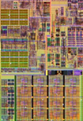
Performance problem:
False sharing
Core 1
Core 2
MINE!
L1
L1
X
No, MINE!
load line holding B
store line holding D
A
B
C
D
64 bytes of DRAM
Notes:
This slide contains significant animation.
The CPU core stores a copy of its most-used memory locations in its L1 cache.
When retrieving a word of memory, it will also retrieve all of the other words in the same cache line (64 bytes on x86-derived architectures).
If Core 2 writes to a cache line that is present in Core 1’s L1 cache, then it must invalidate the line in Core 1’s cache. The next time Core 1 needs to access that cache line, it will need to retrieve it again from a shared cache or even from DRAM.
The inter-core communication and memory accesses needed to keep the caches coherent dramatically reduce multicore performance.
This is why data races often manifest as performance problems.
If the two memory accesses are to different words within the same cache line, there is no data race, but the performance impact is the same.
This phenomenon is called “false sharing”.
Note that false sharing is a performance bug not a correctness bug.

Slide 32
Avoiding false sharing
constexpr size_t M = 10000, N = 7;
double my_data[M][N];
…
cilk_for (size_t i = 0; i < M; ++i)
modify_row(my_data[i]);
0,0 |  |  |  |  |  | 0,6 | 1,0
 |  |  |  |  | 1,6 | 2,0
 |  |  |  | 2,6
unaligned rows
constexpr size_t M = 10000, N = 7;
constexpr size_t cache_line = 64;
struct row {
alignas(cache_line) double m[N];
};
row my_data[M];
unused
0,0 |  |  |  |  |  | 0,6
1,0 |  |  |  |  |  | 1,6
2,0 |  |  |  |  |  | 2,6
cache-aligned rows
constexpr size_t M = 10000, N = 7, cache_line = 64;
constexpr size_t N2 = ((N*sizeof(double) + cache_line-1) &
~(cache_line–1)) / sizeof(double);
alignas(cache_line) double my_data[M][N2];
Notes:
Unfortunately, cache alignment and cache-line length are low-level constructs and I am unaware of any reasonable high-level abstraction to hide them.
Mitigation strategies for false sharing are therefore dependent on manually tweaking data layout to avoid cache-line sharing.
The first example shows unmodified code with likely false sharing. Rows are modified in parallel. Row 1 shares cache lines with both row 0 and row 2.
The second example avoids false sharing by making sure that each row is struct with forced alignment to a cache line.
The third example computes makes each row a little larger so that its size is a multiple of a cache line. The entire array is forced to be cache aligned.

Slide 33
Performance bug:
Insufficient parallelism
cilk_spawn short_func();
cilk_spawn long_func();
cilk_spawn short_func();
short_func();
cilk_sync;
Work units:
= 5 units
= 1 unit
W = Total work = 39
S = Span (work on the critical path) = 23
P = Parallelism= W / S = 39/23
Maximum parallel speedup
< 2
Notes:
In this diagram, spawns and syncs are shown as small (single unit) circles, short_func() is a 5-unit circle and long_func is 4 x 5 units.
The critical path, shown in yellow, goes through long_func().
Although there are 3 spawns, the actual parallelism is less than 2.
When parallelizing a program, it is important to subdivide the work such that the critical path is not too long relative to the total amount of work.
This principle is the generalization of Amdal’s law.
You can also have insufficient parallelism if your parallel tasks are too course.
Conversely, you can have excessive scheduler overhead if your parallel tasks are too fine-grained.
Parallel programming, like programming in general is a combination of art and science.
It takes a while to build up experience and learn the pitfalls.

Slide 34


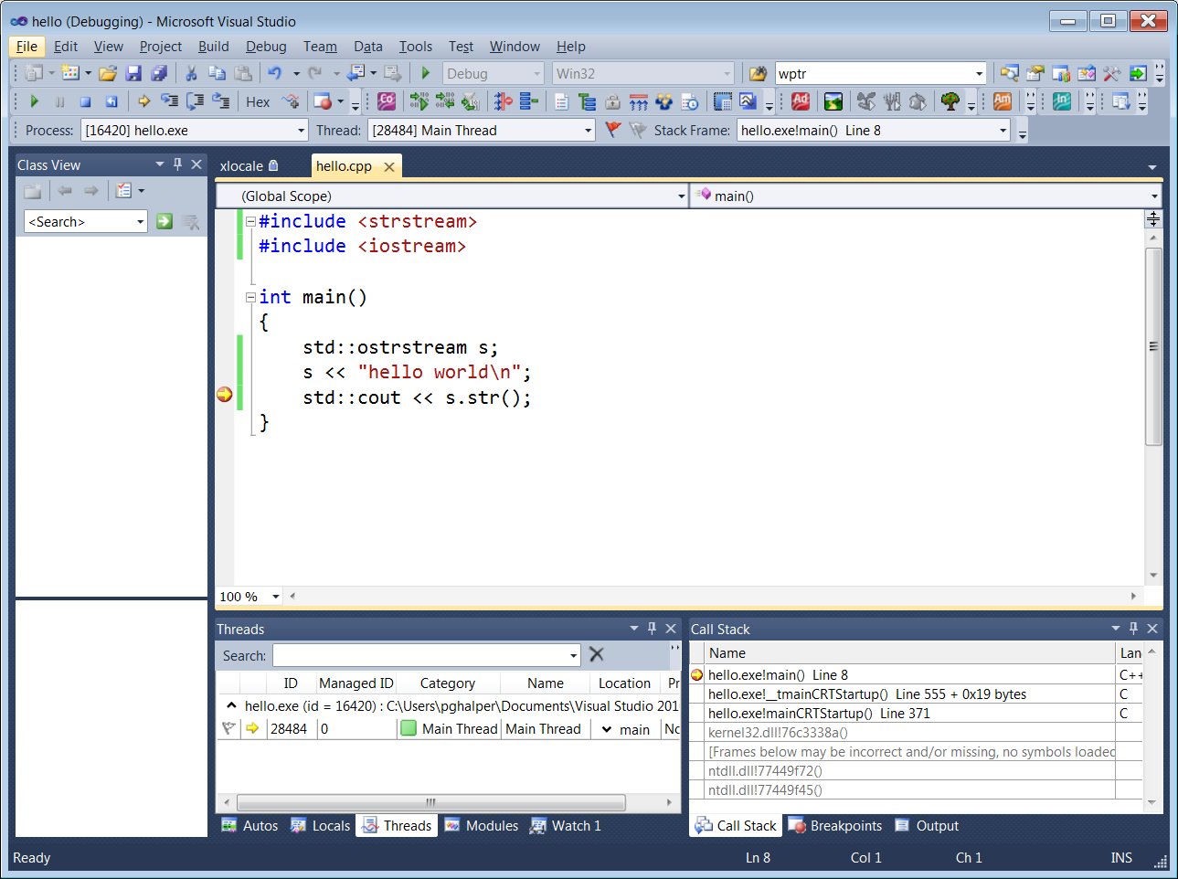
Serial challenges magnified
Memory bandwidth limitations:
Single core: bad.
Multicore: worse!
Debugging:
Single thread: hard.
Multithread: harder!
Notes:
Writing parallel programs has special challenges.
Even the old challenges of serial programs are magnified!
Processors these days are much faster than main memory. When processing large amounts of data, memory bandwidth can become a limiting factor. This limitation is magnified by having multiple cores trying to process large amounts of data at once. In fact, with some operations, you may seen virtually no speedup, despite a lot of theoretical parallelism.
Unfortunately, memory bandwidth problems are difficult to diagnose. The remedy may involve restructuring code for better cache locality.
Debugging parallel programs can be made easier in most cases by debugging with only one core (worker). Of course, that will hide any problems caused by parallelism, but any serial errors should be easier to find and fix.

Slide 35
Next steps
Attend other CppCon sessions on parallelism, including my session on decomposing a problem for parallelism.
Obtain a parallel compiler or framework and work through some tutorials.
Get tools to help:
  Race detector (Cilkscreen, Intel® Inspector XE, Valgrind)
  Parallel performance analyzer (Cilkview, Cilkprof, Intel® VTune Amplifier XE)
Notes:
Nothing in software engineering gets cemented in your brain until you apply it. Get gcc or the Intel compiler and start playing with Cilk Plus, or try OpenMP, TBB, or PPL.
Intel® Inspector XE and Vtune Amplifier XE are part of Intel® Parallel Studio XE, which also includes Parallel Composer XE, the Intel compiler that includes Cilk Plus as well as TBB.

Slide 36
Resources
Intel® Cilk™ Plus (including downloads for Cilkscreen and Cilkview): cilkplus.org
Intel® Threading Building Blocks (Intel® TBB): www.threadingbuildingblocks.org
OpenMP: openmp.org
Intel® Parallel Studio XE (includes VTune™ Amplifier and Inspector XE: https://software.intel.com/en-us/intel-parallel-studio-xe

Slide 37
Thank You!

Slide 38
Growth of parallel resources on Xeons
Intel® Xeon® Processor | Year | cores (2S) | SIMD | Lanes
X5472 | 2007 | 8 | SSSE3 (128) | 32
X5570 | 2009 | 8 | SSE4.2 (128) | 32
X5680 | 2010 | 12 | SSE4.2 (128) | 48
E52690 | 2012 | 16 | AVX (256) | 128
E52697 V2 | 2013 | 24 | AVX (256) | 192
E52697V3 | 2014 | 28 | AVX2 (256) | 224
Parallel speed-ups
Intel® Advanced Vector Extensions (Intel® AVX); Intel® Advanced Vector Extensions 2 (Intel® AVX2) ; Intel® Streaming SIMD Extensions [xx] (Intel® SSE[xx])
Notes:
2S = 2 sockets
Since 2007 SIMD instruction set has evolved from 4 SP lanes to 8 SP lanes per core.
Number of cores per socket has increased from 4 to 14
Parallel speedup reflects these changes.

Slide 39
How does it work?
Anatomy of a spawn (vocabulary)
void f()
{
cilk_spawn g();
work
work
work
cilk_sync;
work
}
void g()
{
work
work
work
}
spawn
spawning function (parent)
spawned function (child)
continuation
sync
Notes:
Before diving into the implementation concepts underlying parallel execution, we need to have a vocabulary

Slide 40
Serial Execution
void f()
{
g();
work
work
work
work
}
void g()
{
work
work
work
}
Notes:
This slide has extensive animation. Make sure to view in presentation mode.
If the program is not annotated with parallel keywords, we get normal serial execution.
This should not be a surprise to anybody.

Slide 41
Work Stealing when no other worker is available
void f()
{
cilk_spawn g();
work
work
work
cilk_sync;
work
}
void g()
{
work
work
work
}
Worker A
Same behavior as serial execution!
Notes:
This slide has extensive animation. Make sure to view in presentation mode.
This code is annotated, but the scheduler has no spare resources available.
In the Cilk scheduler, the spawn and sync annotations have no effect in this scenario.

Slide 42
Work Stealing when another worker is available
void f()
{
cilk_spawn g();
work
work
work
cilk_sync;
work
}
void g()
{
work
work
work
}
steal!
Worker A
Worker B
Worker ?
Notes:
This slide has extensive animation. Make sure to view in presentation mode.
Here, the scheduler has at least one spare worker (CPU) Core 1vailable to help out.
The work-stealing scheduler automatically load-balances:
An idle worker will find work to do.
If the program has enough parallelism, then all workers will stay busy.
This form of work-stealing is called “continuation stealing”.
The other common form of work-stealing is “child stealing”, where Worker A executes the continuation and Worker B steals the child call.
A child-stealing scheduler almost never follows the serial execution order, but still works with a single worker.

