Slide 1

Anatomy of a Smart Pointer
Michael VanLoon
CPPcon 2014
michaelv@NonComposMentis.net

Slide 2
What is a smart pointer?
It’s a container for a pointer
  It holds your pointer and gives it back to you
  It facilitates RAII
    Constructs with reasonable defaults
    Cleans up pointer at appropriate time
(Ideally) properly conveys interface semantics
  Shared, unique, etc.

Slide 3
What is a smart pointer?
It’s a proxy for a pointer
  It stands in for the pointer in many cases where you might use the raw pointer
  In many cases it can act as if it is the original pointer type

Slide 4
Various kinds of smart pointers
“Generic” smart pointers:
  auto_ptr
  scoped_ptr
  unique_ptr
  shared_ptr
  weak_ptr
  _com_ptr_t
  CComPtr

Slide 5
Various kinds of smart pointers
Domain-specific smart pointers:
  std::string
  _bstr_t
  _variant_t

Slide 6
The different kinds of reference counting
Object-based reference counting
  The count is stored in the object
  Microsoft COM model
  Sometimes referred to as “intrusive” (boost::intrusive_ptr)
Container-based reference counting
  The count is stored in the smart pointer container
  shared_ptr style

Slide 7
Object-based reference counting
Advantages
  Very simple smart pointer logic
  Can easily mix with raw pointer usage
  Object has greater visibility into its lifetime and cleanup
  Lighter weight overall
Disadvantages
  Outside the COM world, less familiar
  Outside the COM world, no ready-made solution
  Object itself becomes slightly bigger and more complex

Slide 8
Container-based reference counting
Advantages
  Can contain pointer to any objet; no added object knowledge or complexity
  Very standard and widely used
Disadvantages
  Difficult to mix with raw pointer usage
  Heavier weight overall because of complexity of good shared_ptr implementation

Slide 9
How it works: object-based reference counting
Sorry this talk is too short, so here’s what you get:
  Stick an atomic count in an object
  Provide methods to add and release references
  Object deletes itself when reference goes to zero

Slide 10
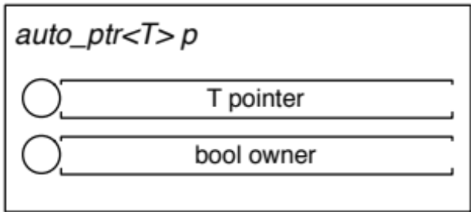
How it works: auto_ptr
Contains raw pointer and an ownership flag
Ownership is transferred to last auto_ptr to contain pointer
Problematic and error-prone ownership semantics, so it’s deprecated!

Slide 11
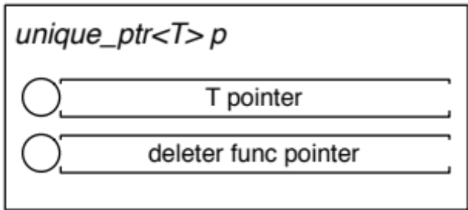
How it works: scoped_ptr and unique_ptr
Contains raw pointer
Does now allow transfer of ownership (except via move in unique_ptr), which simplifies logic
unique_ptr optionally contains pointer to custom deleter func, which will be called instead of delete if desired

Slide 12
How it works: shared_ptr
High level overview:
Contains a pointer and a reference count that is shared among all instances
Contains optional custom deleter
Last releaser decrements reference to zero, and object is deleted

Slide 13
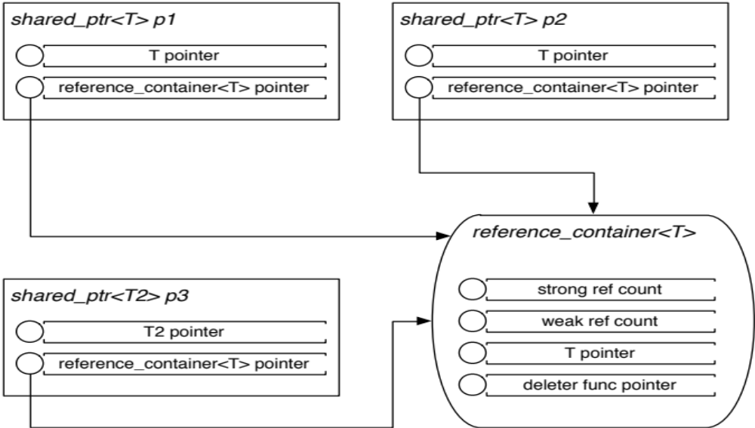
Example shared_ptr implementation
Notes:
This is a QUICK overview
Sample implementation of shared_ptr
Two shared_ptr<T>s
A shared_ptr<T2> created from cast of a shared_ptr<T>, where T2 is a type related to T (such as a subclass or superclass)
A reference_container for a T*, with counts and a deleter
Deleter is stored in reference_container block only for pointer that was allocated
Deleter and allocator are not parts of the shared_ptr type, even when specified (they are constructor parameters)
The pointer is stored both in the reference_container block for the deleter, and in each shared_ptr for fastest retrieval performance

Slide 14
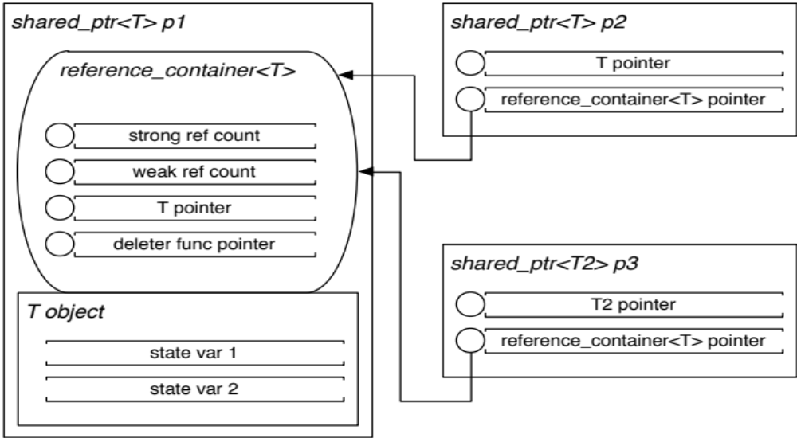
Example make_shared optimization

Slide 15
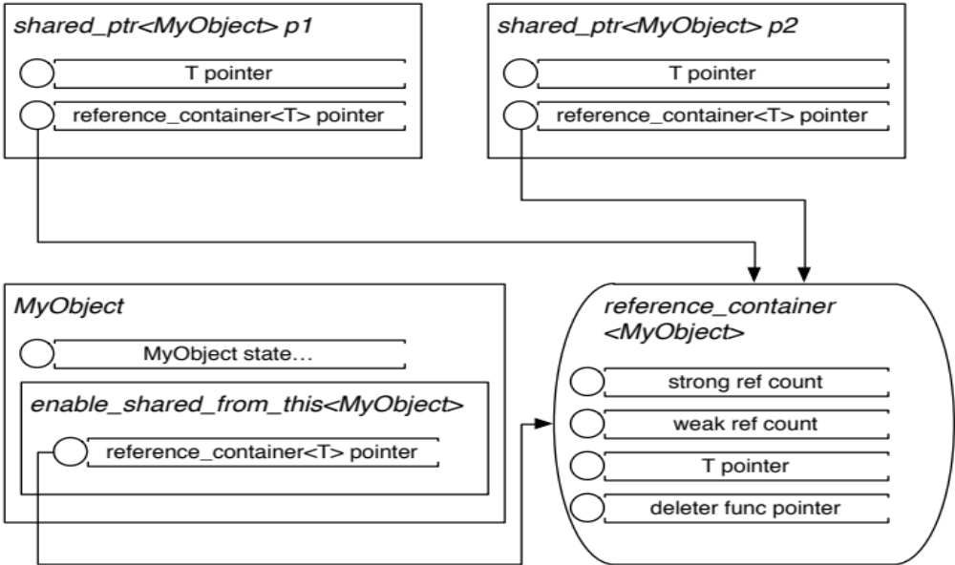
Example enable_shared_from_this

Slide 16
Summary
Use a smart pointer. It avoids the explicit, problematic manual delete
Prefer unique_ptr (or boost::scoped_ptr if you don’t have C++11 yet) because of its efficiency and simplicity if possible
Use shared_ptr for any variables that need shared semantics
Use make_shared when possible; it may be more efficient, and avoids explicit new
Consider object-based reference counting for cases where it fits a paradigm better

