Slide 1
Where did my performance go?
(Scaling visualization in concurrent C++ Programs)
Fedor G Pikus
Mentor Graphics, Design2Silicon Division
CPPCon, September 2014

Slide 2
What Is This Talk About?
How to get a detailed and useful profile (timeline of events) of a concurrent program.
  Why do we need it? What problems do we want to solve?
  What new problems did we create? How to solve them?
  Some useful techniques and tricks.
  Some clever code (a bit simplified).
  Some simpler than expected code (warning: this may be rather anticlimactic).
General assumptions and limitations:
  Reasonably current Linux/Unix
  64-bit address space (applying to 32-bits is possible but requires some careful coding)
  I’ve only tested this on x86/64 hardware
Ask questions (or I will!)

Slide 3
Why measure and profile performance?
Performance is important
  C++ is a performance-oriented language
  C++ is often used when performance is a requirement
Measurements are important
  Programmers are notoriously bad at intuiting performance characteristics
  Performance often depends on subtle details of the program, data, libraries, OS, and hardware
Performance of concurrent programs (more) often depends on more and subtler details of the program, data, (more) libraries, OS, and (more) hardware
  Programmers are notoriously worse at intuiting behavior of concurrent programs

Slide 4
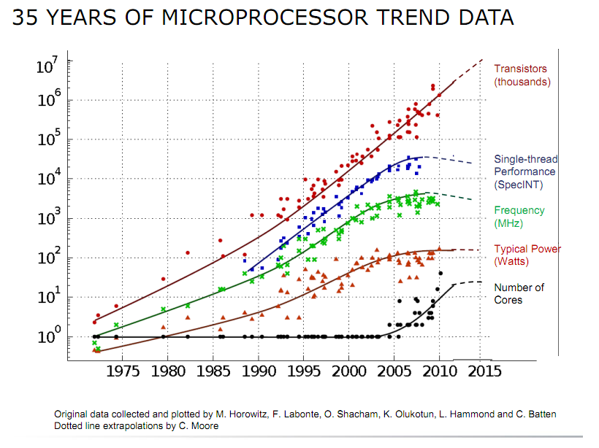
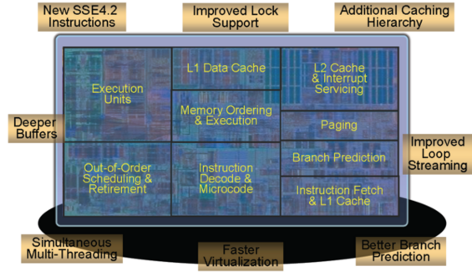
Why write concurrent programs?
The only way to take advantage of the newer processors
Single CPU cores are not getting much faster
CPUs are growing in size and transistor count, most of which goes toward more cores
  more generally, more parallel compute units

Slide 5
How to profile performance of concurrent programs?
Traditional profilers remain useful:
  They identify parts of the code that deserve attention (and parts of the code that can be ignored, performance-wise)
  Many problems become obvious with detailed enough profile
Key difference between profiling sequential and concurrent program:
  Order of execution of a sequential program is known, the only question is how long each step took
  Order of execution of a concurrent program is (somewhat) random but performance may greatly depend on the order

Slide 6
High-Performance program+Concurrency = ?
Program 1
  1 thread – real time: 1s, CPU time: 1s
  2 threads – real time: 0.6s, CPU time 1.1s
  4 threads – real time: 0.9s, CPU time 2s
  64 threads – real time: 10s, CPU time: 100s
Program 2
  1 thread – real time: 1s, CPU time: 1s
  2 threads – real time: 1s, CPU time: 1s
  4 threads – real time: 1s, CPU time: 1s
Program 3
  1 thread – real time: 1s, CPU time: 1s
  2 threads – real time: 1s, CPU time: 2s
  4 threads – real time: 1s, CPU time: 4s

Slide 7
High-Performance program+Concurrency =
Lock Contention
Program 1
  1 thread – real time: 1s, CPU time: 1s
  2 threads – real time: 0.6s, CPU time 1.1s
  4 threads – real time: 0.9s, CPU time 2s
  64 threads – real time: 10s, CPU time: 100s
computation
time
threads
waiting on a lock

Slide 8
Profiling concurrent programs:
Who, What, When?
Peek into the execution of threads
  “Thread microscope” – “Threadscope”?
We want to know:
  which thread did what computation?
  how long it did it take?
  what were other threads doing at that time?
  did other events happen before, after, or simultaneously?
  how long was a wait on which lock?
  which thread was holding the lock at that time?
  how many threads contend for a lock (or a result, in lock-free programs)?
Picture is worth a thousand words: Visualizing the timeline of relevant events can really help to diagnose performance problems

Slide 9
High-Performance program+Concurrency =
Complete Serialization
Program 2
  1 thread – real time: 1s, CPU time: 1s
  2 threads – real time: 1s, CPU time: 1s
  4 threads – real time: 1s, CPU time: 1

Slide 10
High-Performance program+Concurrency =
?
Memory-Bound program
Program 3
  1 thread – real time: 1s, CPU time: 1s
  2 threads – real time: 1s, CPU time: 2s
  4 threads – real time: 1s, CPU time: 4s

Slide 11
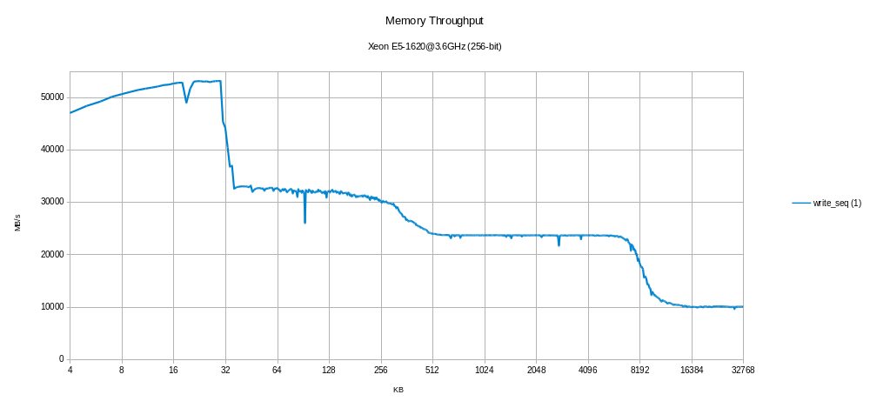
Memory Bandwidth and Memory-Bound

Slide 12
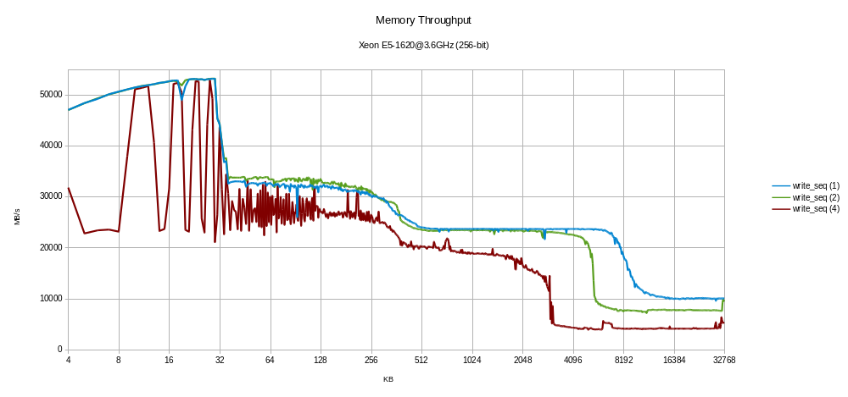
Memory Bandwidth and Memory-Bound
1 thread
2 threads
4 threads

Slide 13
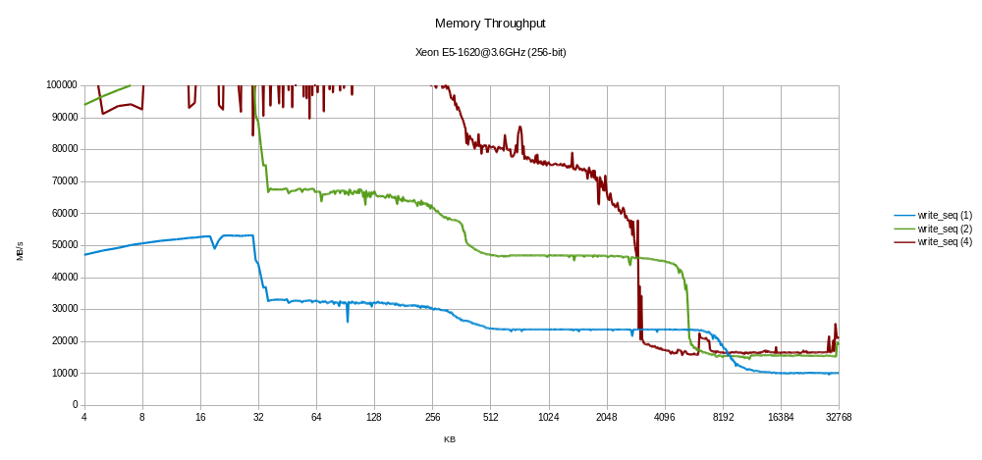
Memory Bandwidth and Memory-Bound
4 threads, *4
2 threads, *2
1 thread

Slide 14
Bonus Example
From Herb Sutter’s talk “Lock-Free Programming”
  CPPCon 2014, Monday Sept 8th
LowLockQueue with several producer and consumer threads

Slide 15
Example 1
Baseline code.
  template <typename T>
  struct LowLockQueue {
  struct Node {
  Node( T val ) : value(val), next(nullptr) { }
  T value; // objects are held by value
  atomic<Node*> next;
  };
  first and last point to the before-the-first and last nodes
  divider points to a boundary between producer and consumer
  Node *first, *last; // for producer only
  atomic<Node*> divider; // shared: P/C boundary
  atomic<bool> producerLock; // shared by producers
  atomic<bool> consumerLock; // shared by consumers

Slide 16
Example 1 (continued)
Consume returns the value in the first unconsumed node.
  Note: The entire body of Consume is inside the critical section, so we get no concurrency among consumers in this code.
  bool Consume( T& result ) {
  while( consumerLock.exchange(true) )
  { } // acquire exclusivity
  if( divider->next != nullptr ) { // if queue is nonempty
  result = divider->next->value; // copy it back to the caller
  divider = divider->next; // publish that we took an item
  consumerLock = false; // release exclusivity
  return true; // and report success
  }
  consumerLock = false; // release exclusivity
  return false; // queue was empty
  }

Slide 17
Example 1 (continued)
Produce adds a new nodeto the tail, then lazily cleans up any consumed nodes at the front of the list.
  Note: Not all of the body of Produce is inside the critical section, so there is some concurrency among producers in this code.
  bool Produce( const T& t ) {
  Node* tmp = new Node( t ); // do work off to the side
  while( producerLock.exchange(true) )
  { } // acquire exclusivity
  last = last->next = tmp; // publish the new item
  while( first != divider ) { // lazy cleanup
  Node* tmp = first;
  first = first->next;
  delete tmp;
  }
  producerLock = false; // release exclusivity
  return true;
  }
  };

Slide 18
Bonus Example
From Herb Sutter’s talk “Lock-Free Programming”
  CPPCon 2014, Monday Sept 8th
LowLockQueue with several producer and consumer threads
Initial implementation yielded “negative scaling”
  2 consumer threads give lower total throughput than 1 thread
Consumer lock was shown to be the main problem
  Consumer workload (memory copy) was inside critical section
Removing cleanup from producer was the next big improvement
  Again, work inside critical section
What would the timeline show?

Slide 19
Example 1 (continued)
Consume returns the value in the first unconsumed node.
  Note: The entire body of Consume is inside the critical section, so we get no concurrency among consumers in this code.
  bool Consume( T& result ) {
  while( consumerLock.exchange(true) )
  { } // acquire exclusivity
  if( divider->next != nullptr ) { // if queue is nonempty
  result = divider->next->value; // copy it back to the caller
  divider = divider->next; // publish that we took an item
  consumerLock = false; // release exclusivity
  return true; // and report success
  }
  consumerLock = false; // release exclusivity
  return false; // queue was empty
  }

Slide 20
Example 1 (continued)
Produce adds a new nodeto the tail, then lazily cleans up any consumed nodes at the front of the list.
  Note: Not all of the body of Produce is inside the critical section, so there is some concurrency among producers in this code.
  bool Produce( const T& t ) {
  Node* tmp = new Node( t ); // do work off to the side
  while( producerLock.exchange(true) )
  { } // acquire exclusivity
  last = last->next = tmp; // publish the new item
  while( first != divider ) { // lazy cleanup
  Node* tmp = first;
  first = first->next;
  delete tmp;
  }
  producerLock = false; // release exclusivity
  return true;
  }
  };

Slide 21
LowLockQueue Timeline (best guess)
consume
consume
consumers
Lock
copy
copy
consume
Lock
copy
producers
produce
produce
new Node
new Node
cleanup
produce
produce
Lock
new Node
new Node
Doing work inside critical section means keeping other threads waiting
Timeline of events (computations, locks) visualizes many problems
  Not all problems (memory contention is not directly visible and has to be inferred, takes practice)

Slide 22
How to get the timeline of a program?
Instrument the program to mark the “interesting” events
  start and end of a function call or another computation
  requesting and acquiring a lock
  start and end of a message or I/O
Run the program, collect the data
Visualize the data
There are profilers that collect similar data (VTune, Sun collector, Visual Studio)
  If you have one and it works, use it first
  They don’t know what are “interesting” events, so they often collect too much data or not enough data
Profiler is often the best source of hints which code to instrument!

Slide 23
What are the challenges?
Any measurement disturbs the program being measured and affects the results
  More so if measurements require synchronization (locks)
Collecting data from multiple threads risks race conditions
  More so if data collection is done without synchronization
Total volume of data can be large
  Adding this much I/O to a program can affect the performance

Slide 24
What are the solutions?
Minimize the overhead added to computing threads
Do most profiling-related work on separate threads
  This takes CPUs/cores away from the program
Reduce resident memory footprint of the profiling
Run I/O on separate threads
work threads
profile processing threads
Profile
Results

Slide 25
What data we may want to collect?
T1
f1(1)
f1(2)
g1(1)
g1(2)
g2(2)
T2
f1(3)
L1
f2()
f3()
g1(3)
g2(3)
What was computed, or what did we wait for?
Real time
CPU time, or CPU load, for the thread
CPU time, or CPU load, for the process
Parameters or other user data
Stack trace
Nesting depth
Collect only what you need, use expensive annotations less frequently

Slide 26
How to collect the data
Minimize the work done on compute threads
Minimize synchronization introduced into compute threads
  Collect only what is necessary
  Collect efficiently
Make instrumenting the program as simple as possible
void f1(int x) {
Collector C(“f1”, x); // Start of f1(x)
… do some work …
result1 = g1(x);
result2 = g2(x);
… do more work …
} // End of f1(x) – ~Collector() collects final data
void g1(int x) {
Collector C(“g1”, x); // Nested task
… even more work …
}

Slide 27
Collect only what is necessary …
What is necessary?
Real time
Task ID
Thread ID
Nesting depth
CPU time, per thread
CPU time, per process
User data
Stack trace
Other state?
We need several data collection classes
Always needed
Almost always needed
Sometimes needed
Special cases

Slide 28
Collect only what is necessary …
Collect where?
Real time
Task ID
Thread ID
Nesting depth
CPU time, per thread
CPU time, per process
User data
Stack trace
Other state?
Collected data needs to be stored in memory
Always needed
Almost always needed
Sometimes needed
Overhead!
Special cases
Allocation!
Data Races!
Synchronization!

Slide 29
Collect only what is necessary …
Collect where?
Real time
Task ID
Thread ID
Nesting depth
CPU time, per thread
CPU time, per process
User data
Stack trace
Other state?
Collected data needs to be stored in memory
Always needed
Almost always needed
Sometimes needed
Special cases

Slide 30
High-resolution Timers on X86/Linux
clock_gettime()
Supports several clocks
  CLOCK_MONOTONIC – real time
  CLOCK_PROCESS_CPUTIME_ID – CPU time per process
  CLOCK_THREAD_CPUTIME_ID – CPU time per thread
Resolution is 1ns BUT timer itself takes about 50ns (real time) to 150ns (CPU time) on a fast processor
We can wrap these library calls into classes HighResThreadTimer and HighResProcessTimer
HighResThreadTimer T;
… do some work …
uint64_t time_ns = T.Time(); // nanoseconds

Slide 31
Memory allocation
We want
  Thread safe allocation
  Low overhead
  Minimally disruptive synchronization
So does everybody else, what’s special here?
We don’t need
  General allocation patterns
    Memory is allocated when new data is added by a work thread
    Memory is no longer needed when data is saved to disk or processed by one of the service threads
  General deallocation
    Deallocation is entirely controlled by our profiler
From the point of view of the work threads, we need a memory pool

Slide 32

Memory Pool
Memory Pool is just a (conceptually) contiguous region of memory with a pointer (or offset)
Allocation from the memory pool is simple:
void* pool_allocate(size_t s) {
void* p = top;
increment(top, s);
return p;
}
Empty
Used
Allocated
top
top’

Slide 33
Thread-safe Memory Pool
Memory Pool is just a (conceptually) contiguous region of memory with a pointer (or offset)
Thread-safe allocation from the memory pool is simple:
void* pool_allocate(size_t s) {
return atomic_increment(top, s); // returns old value
}
After atomic increment, allocated region belongs to the calling work thread, no more data races
Empty
Used
Allocated
top
top’

Slide 34
Simple Data Collector
This is what we want to store in memory
struct TaskRecord {
uint32_t depth; // Record nesting depth
uint64_t tid; // Thread id
uint64_t tag; // User-given identifier (“f1”)
uint64_t start_time; // nanoseconds
uint64_t stop_time;
uint64_t cpu_time;
TaskRecord(int depth, size_t tag, uint64_t start_time) :
depth(depth), tid(pthread_self()), tag(tag),
start_time(start_time), stop_time(0), cpu_time(0) {}
};

Slide 35
Simple Data Collector
This is the collector class
class Collector {
int* depth_;
TaskRecord* record_;
HighResThreadTimer timer_;
public:
Collector(size_t tag);
~Collector();
};
Measured “task” is the lifetime of the Collector
  HighResThreadTimer measures CPU time since its creation
“Depth” counts how many Collector objects are alive on the current thread

Slide 36
Simple Data Collector
This is what we do at the start of the measurement …
Collector::Collector(size_t tag) :
depth_(GetDepth()),
record_(new(pool_allocate(sizeof(TaskRecord)))
TaskRecord(*depth_++, tag, GetRealTime())) {}
}
… and at the end of the measurement
Collector::~Collector() {
record_->stop_time = GetRealTime();
record_->cpu_time = timer_.Time();
--*depth_;
}
atomic_increment()
the thread owns the memory

Slide 37
Simple Data Collector
This is what we do at the start of the measurement …
Collector::Collector(size_t tag) :
depth_(GetDepth()),
record_(new(pool_allocate(sizeof(TaskRecord)))
TaskRecord(*depth_++, tag, GetRealTime())) {}
}
… and at the end of the measurement
Collector::~Collector() {
record_->stop_time = GetRealTime();
record_->cpu_time = timer_.Time();
--*depth_;
}
atomic_increment()
the thread owns the memory

Slide 38
Thread Depth
Thread depth counts the number of Collector objects currently alive on the calling thread
If there is only one thread, depth is a global (static) counter:
No race conditions on depth – only one thread!
No ambiguity as long as all Collectors are stack variables
depth
Collector {
int* depth_;
Collector() { *depth_++; }
~Collector() { *depth_--; }
};
Collector {
int* depth_;
Collector() { *depth_++; }
~Collector() { *depth_--; }
};

Slide 39
Thread Depth
Thread depth counts the number of Collector objects currently alive on the calling thread
If there are many threads, we need per-thread static counter:
No race conditions on depth – one value per thread!
Per-thread static == Thread Local Storage
  GCC: static __thread int depth;
thread 1
thread 2
depth
depth
Collector {
int* depth_;
Collector() { *depth_++; }
~Collector() { *depth_--; }
};
Collector {
int* depth_;
Collector() { *depth_++; }
~Collector() { *depth_--; }
};
Collector {
int* depth_;
Collector() { *depth_++; }
~Collector() { *depth_--; }
};
Collector {
int* depth_;
Collector() { *depth_++; }
~Collector() { *depth_--; }
};

Slide 40
We’re half done!
The picture so far is complete, as far as work threads see
At the beginning of a measurement:
  Allocate memory from the pool
  Store real time
  Increment and store depth
At the end of the measurement:
  Store real time
  Decrement depth
  Store CPU time
And never see that memory again!
But somebody else has to…

Slide 41
Thread-safe Memory Pool – Profiler’s View
Profiler has to save the data to disk
  after it stops changing
Profiler has to release the memory, eventually
Profiler has to grow memory pool, too
  Work threads see the abstraction of continuous memory region
  Somebody has to provide this abstraction
All problems would be solved if we had infinite memory
Empty
Ready
Not ready

Slide 42
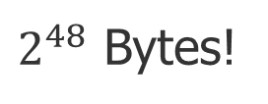
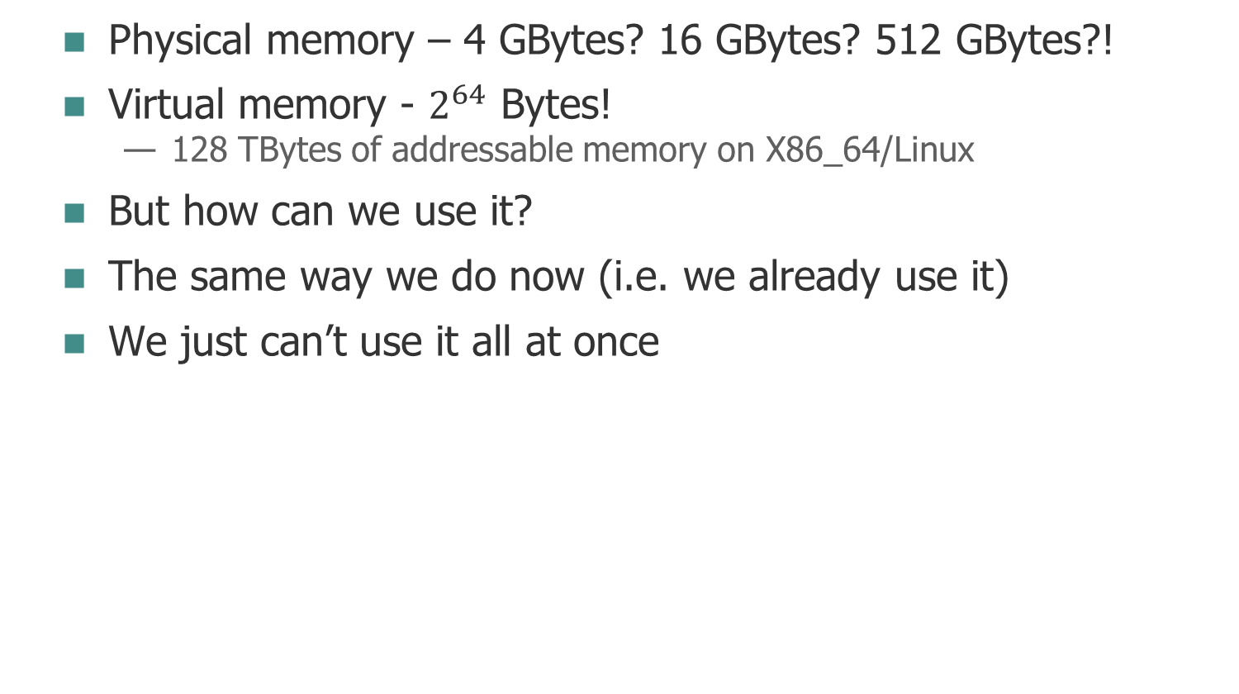

How much memory do we really have?
Physical memory – 4 GBytes? 16 GBytes? 512 GBytes?!
Virtual memory - $2^{64}$ Bytes!
  128 TBytes of addressable memory on X86_64/Linux
But how can we use it?
The same way we do now (i.e. we already use it)
We just can’t use it all at once
$2^{48}$ Bytes!
$2^{47}$ Bytes!

Slide 43
Virtual Memory and Physical Memory
Virtual memory is the logically addressable memory
  This is what your program sees
Physical memory is what the hardware provides
  Not all physical memory belongs to your process
  “Your” physical memory may be non-contiguous
  The same logical address for different processes maps to different physical locations
Address space of a process
0x00…00
0xff…ff
0x00271828
Not Yours
Yours
Not Yours
Yours

Slide 44
Virtual Memory and Memory Maps
Virtual memory is mapped onto physical memory
Virtual and physical memory are organized into pages of fixed size (4K on Linux, usually, but don’t hard-code this!)
Mapping is done by the OS using a PageTable and some help from the hardware (TLB)
PageTable maps process ID and logical page number to physical page number

Slide 45
PageTable, conceptually
Logical address space of process 1
…
PageTable of process 1
Physical memory
PageTable of process 2
…
Logical address space of process 2

Slide 46
Virtual Memory and Memory Maps
Virtual memory is mapped onto physical memory
Virtual and physical memory are organized into pages of fixed size (4K on Linux, usually, but don’t hard-code this!)
Mapping is done by the OS using a PageTable and some help from the hardware (TLB)
PageTable maps process ID and logical page number to physical page number
  Very efficiently!
A logical page can map to
  physical memory page (including shared memory)
  swap page
  disk file page (swap is just a kind of disk file)
  nothing

Slide 47
Managing Memory Maps
Most of the address space of a process maps to nothing
  What fraction of the 128TB are you really using?
  PageTable is really efficient when mapping pages to nothing
How can you map a page to physical memory?
  Access it (read or write)
  The very first access yields a zero-filled page
  Not so for pages you get from malloc() – your access is not first
How can you map a page back to nothing?
  madvise(address, length, MADV_DONTNEED);
  address and length have to be aligned on page size
  how to get page size? sysconf(_SC_PAGESIZE)
  Don’t do this on a page you got from malloc()!
How can you map a page to disk?
  mmap(…, length, …, file_descriptor, … )

Slide 48
Creating Memory Maps
mmap() is used to map a range of logical addresses onto a disk file, a shared memory region, or a region of physical memory
  Accessing memory creates “proxy” pages in physical memory
  Files created by mmap are usually sparse (file size > used space)
Range of logical address space
Physical RAM
Disk space

Slide 49
Creating Memory Maps
mmap() is used to map a range of logical addresses onto a disk file, a shared memory region, or a region of physical memory
  Accessing memory creates “proxy” pages in physical memory
  Files created by mmap are usually sparse (file size > used space)
Pages mapped by mmap() are not “real” until they are accessed – they don’t count against the resident set
Physical memory pages can be released by madvise()
  Not giving up logical addresses, can access the page again
  If the map is backed by a disk file, data on disk is not erased
  If a disk-backed logical page is accessed again, a new physical page is mapped and initialized from disk
munmap() gives up the range of logical addresses

Slide 50
Simple Memory Pool Mirrored to Disk
class DiskPool {
char* addr_; // Initialized by mmap()
size_t len_; // Given by the user
size_t top_; // Offset from address_
public:
DiskPool(size_t l, const char* file) : len_(l), top_(0) {
… addr_ = mmap(…); }
~DiskPool() { … munmap(address_, len_); }
void* allocate(size_t s) {
size_t t = atomic_increment(top_, s); return addr_+t; }
void flush(); // Flush to disk,
// release physical pages
};
work thread’s view
profiler’s view

Slide 51
Asynchronous I/O, the hard way
smart
Because the easy way can’t possibly work…
Profiler needs a thread (or threads!) that
  monitors the pool
  detects when pages are no longer used for storing data (ready)
  flushes these pages to disk
  releases corresponding physical pages
Few days of lock-free coding and some razor blades should do it
Just out of curiosity, what was the easy way?
Empty
Ready
Not ready

Slide 52
Asynchronous I/O, the easy way
What would happen if we released all physical memory mapped to the pool?
  void DiskPool::flush() {madvise(addr_, len_, MADV_DONTNEED);}
All changes still in memory is written to disk
  On some OSes, msync() call is needed for that
All physical memory mapped to the pool addresses is released to the OS and removed from our resident set
Mapping of the virtual address space to the disk file remains intact
If the program accesses (reads or writes) one of the logical pages, a physical page is created from disk data
It behaves the right way, but at what cost?

Slide 53
Don’t Guess, Measure!
class DiskPool {
void flush() {madvise(addr_, len_, MADV_DONTNEED);}
};
I/O thread is really a “flush thread”:
atomic<int> run(1); // Global atomic flag
Flush Thread
while (
run.load(memory_order_acquire)
) {
sleep(1); // 1 second
disk_pool.discard();
}
work threads
…
Main Thread
… all data is written …
run.store(0,
memory_order_release);

Slide 54
Simple Memory Pool Mirrored to Disk
With 32 threads (on 32 cores), we can sustain 1 event per ~100 microseconds, on each thread
  With more than 32 threads we need to throttle it down a bit
  Peak rate can be ~1event/1usec as long as the average rate is ok
PageTable is amazingly efficient!
class DiskPool {
char* addr_; // Initialized by mmap()
size_t len_; // Given by the user
size_t top_; // Offset from address_
public:
void* allocate(size_t s) {
size_t t = atomic_increment(top_, s); return addr_+t; }
void flush() {madvise(addr_, len_, MADV_DONTNEED);}
};

Slide 55
What happens when the pool fills up?
The easy way: the program dies
  Do you really want TeraBytes of profiling data?
  Practical observations: 32 threads, 12 hours of run time, all the instrumentations needed to explain program behavior in details – not even close (<100GB)
The harder ways (also the 32-bit way)
  Roll over the end of the memory range, start writing from the beginning (must save disk content first)
  Freeze the whole system and map new memory ranges
In any case, this is a very rare event, it can be expensive

Slide 56
ThreadScope Annotations - Example
Annotations record when something begins and ends, and how much CPU time was consumed
  All annotations implicitly create an object and measure its lifetime
Process records measure per-process CPU time
THREADSCOPE_TIMED_PROCESS(“Simulation”);
THREADSCOPE_TIMED_IPROCESS(“tile”, tile_number);
THREADSCOPE_TIMED_SPROCESS(“model“, model->name());
THREADSCOPE_TIMED_SPRINTF_PROCESS(
“step %s(%d)“, model->name(), tile_number);
The name of the annotation and the additional information will be displayed by the viewer
Process records can be nested, will display parent-child or “contains” relation

Slide 57
More ThreadScope Annotations
Task records measure per-thread CPU time
  Task records can be nested too
  Process records are more expensive than task records
THREADSCOPE_TIMED_TASK(“Processing tile”);
THREADSCOPE_TIMED_ITASK(“tile”, tile_number);
Lock and Wait records are the only records with explicit “end”
THREADSCOPE_LOCK_BEGIN(L1, “Global lock”);
ScopeLock L(&global_lock);
THREADSCOPE_LOCK_END(L1)
Event record does not have duration
THREADSCOPE_EVENT(“Started processing”);
THREADSCOPE_PENDING_EVENT( “Done processing”);
Unique name
Same name
Event happens on this line
Event happens at the end of the scope

Slide 58
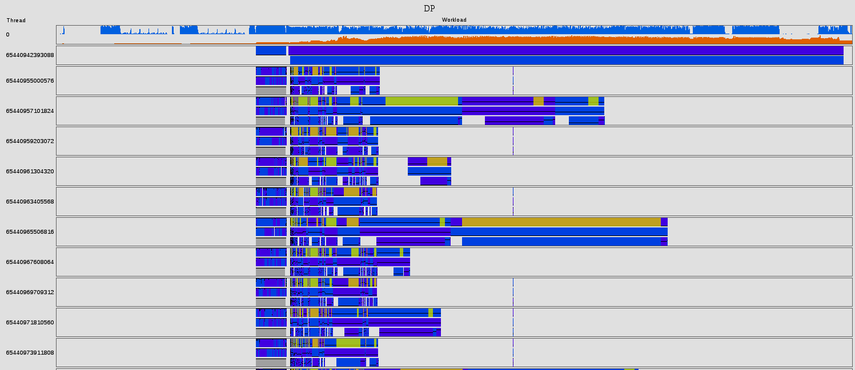
Lazy UI – Visualize using CSS/HTML
CPU utilization
Memory use
Mouse-over pop-up shows details
Each bar is a record
of some measurement
Nested records, or “sub-records”
Can view results “live”
Thread ID
Time axis

Slide 59
But I really want to do things the hard way…
Some measurements require more processing
  More frequent measurements
  Measurements involving stack traces
These measurements require some sort of accumulation
  1 event per microsecond? Even if you could collect that much raw data, what would you do with it?
Example: profiling memory allocation
  We can collect stack trace at every allocation and deallocation
  We can’t write this much data to disk
  We need to process (accumulate) the data, for example, count the total number of allocations for each stack trace

Slide 60
How to accumulate data during profiling
Work threads still generate events and writes into the pool but the pool is not backed by disk
Processing thread sweeps the pool, reads the data, does the processing, releases physical memory, writes the results into another (disk) pool
  Profiler thread needs to know which data is ready
Flush thread flushes disk pool, releases physical memory
  Processing thread will page in some memory as needed, flush thread will release these pages again
(?)
Empty
Released
Ready
Not ready
(?)

Slide 61
Anonymous Memory Pool
mmap() can be called without a file
  pass -1 for file descriptor
Result is a chunk of reserved virtual address space
  No physical memory is allocated, yet
  All logical pages are mapped to nothing
  Your malloc() probably does that, deep inside
When a page is accessed, a physical page is mapped
  New page is zero-filled
When a page is released with madvise(), its content is gone – it will be all zeroes if it’s read again
Reserved address space counts as virtual memory size but not as the resident set
  Linux kernel has some settings that can (try to) change that

Slide 62
Profiling With Stack Traces
Example – counting memory allocations per stack trace
Work threads must extract stack trace and store it in the pool (together with allocation size, thread id, etc)
struct TaskRecord {
uint32_t count; // Count of stack frames
void* stack[1]; // “struct hack”
};
Processing thread sweeps the pool until it finds the first uninitialized record (count == 0)
But, but… data races?!
Make the count atomic!
Work Thread
… save stack trace …
release_store()
Processing Thread
while (acquire_load()) {
… process and release …
}
TaskRecord {
atomic<unit32_t> count;
};

Slide 63
Processing in Background
Work Thread
write
allocate
Empty
Released
Ready
Not ready
memory
pool
p
while (n = acquire_load(p->count)) {
read_stack(p);
if (look_up_stack() == false)
new_stack();
update_stack_count();
discard(begin, p++);
}
discard
read
stop
Sweep Thread
write
allocate
Empty
Ready
Not ready
disk
pool
discard
Flush Thread

Slide 64
If one thread is good, two must be better
We have one consumer (sweep) thread trying to keep up with multiple producer (work) threads.
If there are enough producer threads, consumer thread can become saturated.
  Sweep falls behind – memory accumulates – memory runs out
Add another consumer thread
  More complex synchronization (atomic count updates, atomic stack lookups/additions)
Pipeline processing
  First thread counts stacks
  Second thread converts stack pointers to symbols
  Use another memory pool to pass data between pipeline stages

Slide 65
What have we learned?
Writing high-performance concurrent programs is hard
  Harder still for memory-bound programs
Timeline of concurrent execution makes debugging performance problems easier
Low overhead is key
  Low-overhead memory allocation
  Low-overhead synchronization
Lock-free programming is easy if we have infinite memory
Sometimes we can have infinite memory
Thread-local data is like per-thread static
Pipelines as an alternative to data sharing

