Slide 1

Make Simple Tasks Simple!
Bjarne Stroustrup
Morgan Stanley
Columbia University, Texas A&M University
www.stroustrup.com

Slide 2
Abstract
C++ faces two challenges:
  Help programmers address the most demanding tasks in terms of performance, scale, and dependability
  help programmers be productive writing ordinary maintainable code
There is much more “ordinary code” than there is performance-critical code. Thus, C++ must make simple tasks simple while not getting in the way of tuning software for the last byte and last cycle where that’s necessary. This talk focuses on what C++11 and C++14 offers to simplify programming: auto, range-for loops, move semantics, concepts, and more. However, the focus is not primarily on language features: the key is programming: how can we write better, more readable, efficient, and more maintainable code? If you think that the essence of C++ is clever pointer manipulation and huge class hierarchies you may be in for a few surprises.

Slide 3
Executive Summary
Keep simple things simple
Don’t make complex things unnecessarily complex
Don’t make things impossible
Constraint: Don’t sacrifice performance
C++ is expert friendly
  and becoming more so
C++ must not be just expert friendly
  Serving novices and “occasional users” is very important
  Most of the time, I don’t want to be a language lawyer

Slide 4
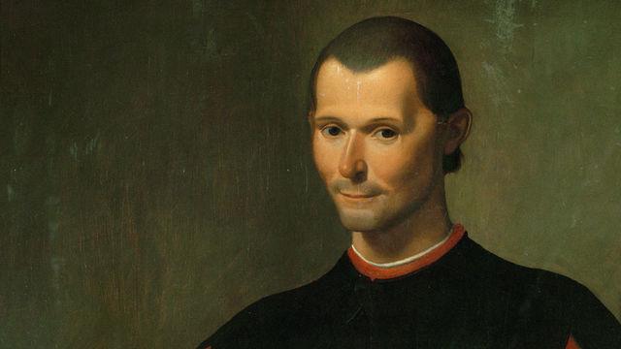
… there is nothing more difficult to carry out, nor more doubtful of success, nor more dangerous to handle, than to initiate a new order of things. For the reformer makes enemies of all those who profit by the old order, and only lukewarm defenders in all those who would profit by the new order …
We are heavily invested in C++98 code, techniques, and tools, so …

Slide 5
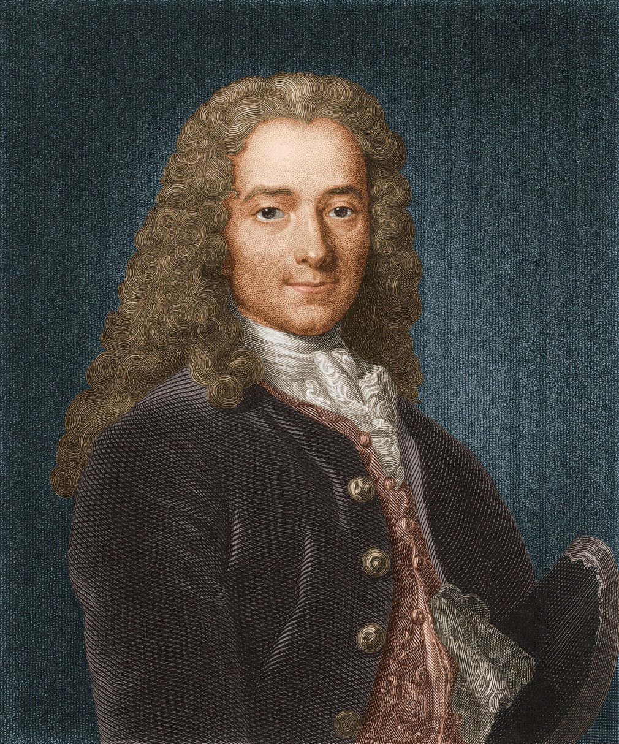
“The best is the enemy of the good.”
Clever programmers like clever code
Language enthusiasts like advanced features

Slide 6
Overview
Preamble
What is “simple”?
Loop example
Resource example
Generic programming is (just) Programming
What next?

Slide 7
Being too clever is not clever
BWK (1976)
  “debugging is twice as hard as writing the program in the first place. So, if you’re as clever as you can be when you write it, how can you debug it?”
Design for clarity
  Essential complexity
    What is needed to defeat to solve the problem
    Try to find the simplest solution
  Accidental complexity
    introduced by the expressions of the solution
    Minimize it by using C++ well
  Don’t over-abstract
    Base generalizations on concrete solutions
  Hide complexity
    Good interfaces are essential

Slide 8
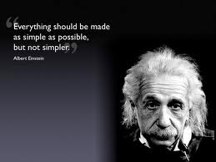
Make simple things simple!
What does “simple” mean?
Make the code directly express intent
  Simple code is easier to understand
  Simple code is often beautiful
  Simple code is often fast
  Not all code can be simple
    Hide the complexity behind a simple interface

Slide 9
“Simplify” is not a new idea in C++
The (1979) traditional style
    X x; // uninitialized
    … // don’t use x here
    init(x); // make x ready for use
    … // don’t init(x) here
    cleanup(x);
    … // don’t use x here
    … // don’t use cleanup(x) here
1979 (paraphrased using modern terminology):
  A constructor establishes the run-time environment for member functions (incl. acquiring the resources needed) aka establish invariant
  A destructor reverses the action of the constructor (incl. releasing any resources owned)

Slide 10
Make simple things simple!
A modern (post 1979) use: { X x; … }
A constructor/destructor pair
  makes the programmer’s intent explicit
  eliminates some classes of errors
    Use before initialize
    Double initialization
    Double destruction
  Creates a couple of new problems
    How to report failure to construct?
      => exceptions
    How to avoid double destruction when people use new/delete?
      => GC? (no)
      smart pointers (and problems with managing ordinary pointers)
      Avoid “naked” new/delete

Slide 11

Loops

Slide 12
Loop example
A simple example from a friend
  A production code example reduced to its essentials
  Good production code
  // old code:
  std::vector<MemoryBuffer>::const_iterator cit = MemVec.cbegin();
  for ( ; cit != v.end(); ++cit) {
  if (LookForPattern(*cit))
  return true ;
  }
  return false;

Slide 13
Loop example
Use auto
  the oldest C++11 feature
Put the for-initializer into the loop where it belongs
  // first step:
  for (auto cit = MemVec.cbegin(); cit!=v.end(); ++cit) {
  if (LookForPattern(*cit))
  return true ;
  }
  return false ;

Slide 14
Loop example
Convert to a range-for loop
  We do not know we have a regular loop
  No “fiddling” with the iterator
  // second simplification:
  for (const auto& x : v)
  if (LookForPattern(x))
  return true ;
  return false ;

Slide 15
Loop example
“Obviously” we should have used an algorithm
  It was not obvious to good programmers at the time
  Not all loops reduce to a standard-library algorithm
  // good:
  return find_if(cbegin(v), cend(v), LookForPattern) != cend(v) ;

Slide 16
Loop example
I’m tired of writing v.begin(),v.end()
  It’s general, but
  It exposes implementation
  Use a container/range algorithm
  // my variant:
  return find_if(v,LookForPattern)!=cend(v);

Slide 17
Loop example
A container/range algorithm
  Maybe you just happen to have one lying around
  It should be part of the standard library
  There is a TS for such simplifications
  // range version of std::find_if:
  template<typename Cont, typename Pred>
  Iterator<Cont> find_if(Cont& c, Pred p)
  {
  return std::find_if(begin(c),end(c),p);
  }

Slide 18
Loop example
What is Iterator<Cont>?
  A template alias
  Should be standard
  // my variant:
  template<typename T>
  using Iterator = typename T::iterator;

Slide 19
Loop example
Question
  What would you have said if I five years ago had promised that you could halve the size of that code?
Answer
  Snake oil!
Fact
  That code is in production today
  Incremental improvement can get us a long way
  Progress happens

Slide 20
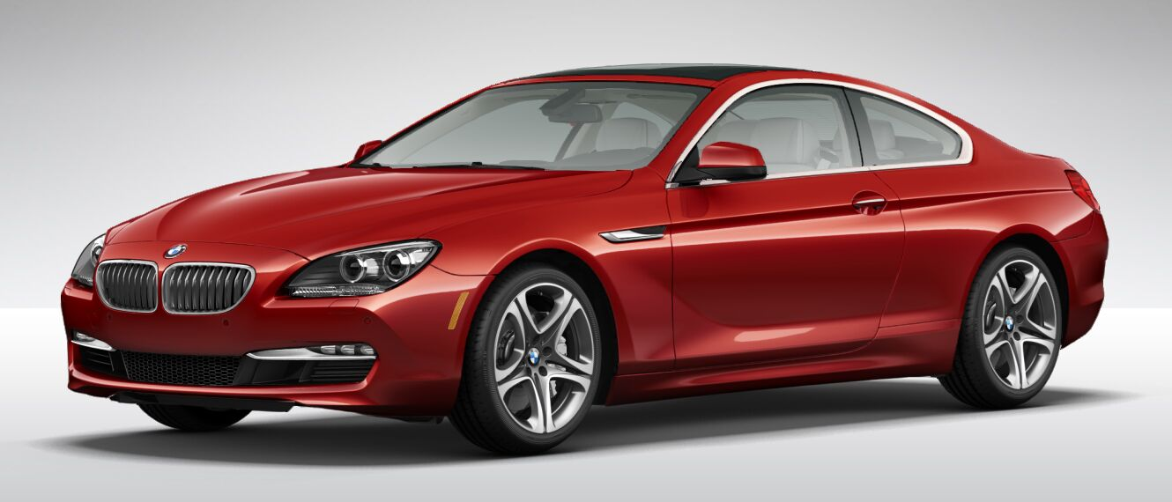
Resource Management

Slide 21
Resource management example
Collect copies of elements (C++98 style)
  vector<string>* collect_s(char ch)
  // copy words staring with ch from cin
  {
  vector<string>* p = new vector<string>;
  string s;
  while (cin >> s)
  if (s[0] == ch)
  p->push_back(s);
  return p;
  }

Slide 22
Resource management example
Collect copies of elements (C++98 style)
  Remember to delete
  Use pointer notation
  void use1()
  {
  vector<string>* strings = collect_s('s');
  // ... usage: (*strings)[n] …
  delete strings;
  }

Slide 23
Resource management example
Collect copies of elements (naïve C++11 style)
  Use smart pointers to eliminate leaks
  void use2()
  {
  shared_ptr<vector<string>> strings {collect_s('s')};
  // ... usage: (*strings)[n] …
  // delete strings;
  }
  void use3()
  {
  unique_ptr<vector<string>> strings {collect_s('s')};
  // ... usage: (*strings)[n] …
  // delete strings;
  }

Slide 24
Resource management example
Return container by value
  Rely on move constructors
  vector<string> collect(char ch)
  // copy words staring with ch from cin
  {
  vector<string> res;
  for (string s; cin >> s; )
  if (s[0] == ch)
  res.push_back(s);
  return res;
  }

Slide 25
Resource management example
Return container by value
  Rely on move constructors
  No pointers and no leaks
  No pointer notation
  void use4()
  {
  auto strings = collect('s') ;
  // ... usage: strings[n] …
  }

Slide 26
Resource management example
Generalize
  Still return by value
  template<typename Iter, typename Predicate>
  vector<Value_type<Iter>> collect(Iter first, Iter last, Predicate pred)
  // copy elements that meets pred() from [first:last)
  {
  vector<Value_type<Iter>> res;
  for (auto p = first; p!=last; ++p)
  if (pred(*p))
  res.push_back(*p);
  return res;
  }

Slide 27
Resource management example
Generalize
  Test with a variety of sequences, element types, and predicates
  bool odd(int x) { return x % 2; }
  void test()
  {
  auto lst = { 1, 2, 3, 4, 5, 6 };
  auto ss = collect(begin(lst), end(lst), odd); // {1,3,5}
  }

Slide 28
Resource management example
Generalize
  Test with a variety of sequences, element types, and predicates
  bool initial_s(const string& s) { return s.size() && s[0]=='s'; }
  void user6()
  {
  auto strings = collect(istream_iterator<string>{cin},
  istream_iterator<string>{},
  initial_s);
  }

Slide 29
Resource management example
I still like range/container algorithms
  template<typename Sequence, typename Predicate>
  vector<Value_type<Sequence>> collect(Sequence seq, Predicate p)
  {
  vector<Value_type<Sequence>> res;
  for (const auto& x : seq)
  if (p(x))
  res.push_back(x);
  return res;
  }

Slide 30
Resource management example
I still like range/container algorithms
  And lambda expressions can be useful
  void user()
  {
  // auto ss1 = collect({ 1, 2, 3, 4, 5, 6 }, odd); // error: Bummer!
  auto lst = { 1, 2, 3, 4, 5, 6 };
  auto ss2 = collect(lst, odd); // {1,3,5}
  // auto ss3 = collect(cin, initial_s); // error: logically impossible
  auto ss4 = collect(Istream_range<string>{cin}, initial_s);
  auto is = Istream_range<string>{cin};
  auto ss5 = collect(is, [](auto& s){ return s.size() && s[0] == 's'; });
  }

Slide 31
Resource management example
We need to throw in a trait
  template<typename C>
  struct value_trait { using type = typename C::value_type; };
  template<typename T>
  struct value_trait <T*> { using type = T; };
  template<typename T>
  using Value_type = typename value_trait<T>::type;

Slide 32
Resource management example
We need a helper class
  An istream doesn’t have a value type that we can iterate over
  template<typename T>
  struct Istream_range {
  using value_type = T;
  istream& s;
  // Istream_range(istream& x) : s{ x }{}
  istream_iterator<T> begin() { return istream_iterator<T> {s}; }
  istream_iterator<T> end() { return istream_iterator<T>{}; }
  };

Slide 33
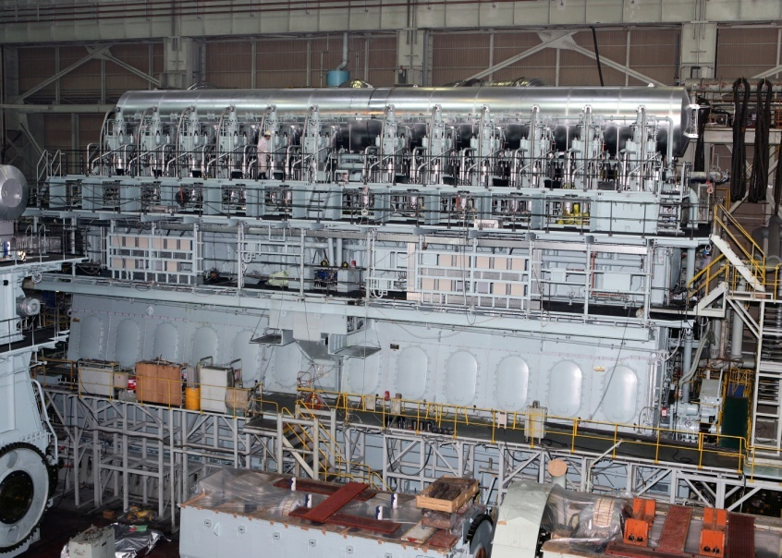
Concepts

Slide 34
Generic Programming
1980: Use macros to express generic types and functions
1987 (and current) aims for templates:
  Extremely general/flexible
    “must be able to do much more than I can imagine”
  Zero-overhead
    vector/Matrix/… to compete with C arrays
  Well-specified interfaces
    Implying overloading, good error messages, and maybe separate compilation
“two out of three ain’t bad”
  But it isn’t really good either ☹
  it has kept me concerned/working for 20+ years

Slide 35
Templates have problems
“Loud” syntax
  template<typename T>
  class X { /* clever members and member functions */ };
Many workarounds are needed
  Too many classes, too many specializations
  The code drowns in “boilerplate”
Odd/different
  Syntax
  Semantics (compile-time “duck typing”)
  Programming style
Error messages are spectacularly bad
  No good interfaces
Use of complicated templates can slow compilation

Slide 36
Templates have been successful
Spectacularly so
  Widespread use
  Influence on many programming languages
We need to
  Provide better support
    Express intent
    Write less code
    Allow greater expressiveness
    Compile faster
    Give better error messages
  Make generic programming “ordinary programming”

Slide 37
Remedies
Use constexpr functions if the result is a value
  constexpr int fac(int n) { return (n>2) ? n*fac(n-1) : n; }
    C++14 allows loops and simple variables in constexpr functions
    constexpr makes compile-time computation conventional and type safe
Use variadic templates to deal with “complicated” arguments
  C++11
  More can be done to simplify: C++17
Constrain template arguments
  Simplifies checking
  Improves error messages
  Enables overloading
Leave template metaprogramming to experts and library implementers

Slide 38
Generic Programming is just Programming
Traditional code
    double sqrt(double d); // C++84: accept any d that is a double
    int x = 7;
    double d2 = sqrt(x); // fine: x can be used as a double
    double d3 = sqrt(&x); // error: &x is not a double
    Generic code (C++14 + concepts)
    void sort(Container& c); // accept any c that is a Container
    vector<string> vs { "Hello", "new", "World" };
    sort(vs); // fine: vs can be used as a Container
    sort(&vs); // error: &vs is not a Container

Slide 39
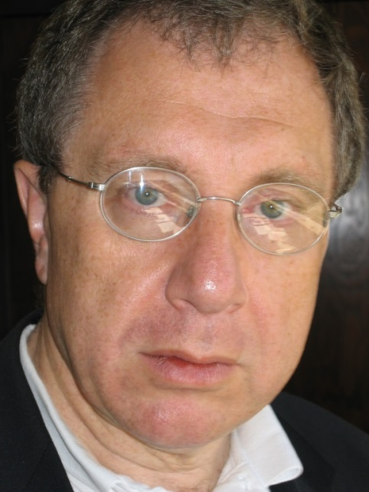
How do we specify requirements for template arguments?
Concepts (aka “concepts lite”)
  state intent
    Explicitly states requirements on argument types
  provides point-of-use checking
    No checking of template definitions
  are predicates
    Boolean constant expressions, incl. constexpr functions
Requirements analysis
  Alex Stepanov, Andrew Lumsdaine, Sean Parent, Bjarne Stroustrup, Andrew Sutton, and a couple of dozen more
Design
  Bjarne Stroustrup, Andrew Sutton, and Gabriel Dos Reis
Implementation
  Andrew Sutton in GCC
TS in its final stages

Slide 40
Concepts
A concept is a predicate on one or more arguments
  E.g. Sequence<T> // is T a Sequence?
Template declaration
    template <typename S, typename T>
    requires Sequence<S> && Equality_comparable<Value_type<S>,T>
    Iterator<S> find(S& seq, const T& value);
Template use
    void use(vector<string>& vs)
    {
      auto p = find(vs,"Jabberwocky");
    // …
    }

Slide 41
Concepts
Error handling is simple (and fast)
  template<typename Cont>
  requires Sortable<Cont> // Sortable is a Sequence with random access
  void sort(Cont& container);
  vector<double> vec {1.2, 4.5, 0.5, -1.2};
  list<int> lst {1, 3, 5, 4, 6, 8,2};
  sort(vec); // OK
  sort(lst); // Error at (this) point of use
Actual error message
  error: ‘list<int>’ does not satisfy the constraint ‘Sortable’
  More information upon request

Slide 42

Concepts
Yes, you can defined your own concepts
  They are simply compile-time constant expressions
  You can use standard-library type_traits
  You can test for valid expressions
    requires(C x) { {f(x)}->int; } // you can call f(x) when x is a C
    // and convert the result to an int
Yes, there is/will be a standard library of concepts
  With concepts like Regular, Ordered, Iterator, Container, Number
No, concepts are not base classes
  But you can write a concept that requires a particular base class
No, concepts are not Java/C# interfaces
  You don’t have to modify types to make them match specifications
No, concepts are not sets of function signatures

Slide 43
Overloading on concepts
But what if we wanted to sort a list?
  template<Sortable Cont> // shorthand: Cont is a type that is Sortable
  void sort(Cont& container);
  template<Sequence Seq>
  void sort(Seq& seq) // sort a sequence that doesn’t offer random access
  {
  vector<Value_type<Seq>> v {begin(seq),end(seq)};
  sort(v);
  copy(begin(v),end(v),seq);
  }
  sort(vec); // OK: use sort of Sortable
  sort(lst); // OK: use sort of Sequence

Slide 44
Concepts work for lambdas
Gratuitous showoff of lambda “magic”
  auto inc1(Number x) { return x+1; } // inc1 increments a Number
  auto z5 = incr(4);
  auto plus = [](Number x) { // nested lambda; see Chris Kohlhepp article
  return [](Number y) { return x+y; }
  } ;
  auto inc4 = plus(4); // inc4 is a function adding 4 to its Number argument
  auto z6 = inc4(2);
  auto z10 = plus(4)(6);
Different people have different ideas of what is simple

Slide 45
auto is the least constrained concept
Gratuitous showoff of lambda “magic”
  auto inc1(auto x) { return x+1; }
  auto z5 = incr(4);
  auto plus = [](auto x) { return [](auto y) { return x+y; } };
  auto inc4 = plus(4); // inc4 is a function adding 4 to its argument
  auto z6 = inc(2);
  auto z10 = plus(4)(6);
I proposed auto as an argument type and a return type in 2002
  Things take time

Slide 46
Simplify!
Make simple things simple
  Don’t make not-so-simple things unnecessarily difficult
  We have (general)
    template<typename Cont> // introduce Cont as a typename
    requires Sortable<Cont> // Sortable is a concept
    void sort(Cont& c); // use Cont as an argument type
  We can abbreviate (“type of type”)
    template<Sortable Cont> // shorthand notation
    // Cont is the name of a type that is Sortable
    void sort(Cont& c);
  We can abbreviate further (“use like a type”)
    void sort(Sortable& c); // terse notation
    // c is an object of a type that is Sortable

Slide 47
From a language point of view
We can use a concept name as the name of a type than satisfy the concept
    void sort(Sortable& c); // terse notation
  means
    template<Sortable __Cont> // shorthand notation
    void sort(__Cont& c);
  means
    template<typename __Cont> // explicit use of predicate
    requires Sortable<__Cont>
    void sort(__Cont& c);
Use the notation that’s most appropriate for the complexity of your problem

Slide 48
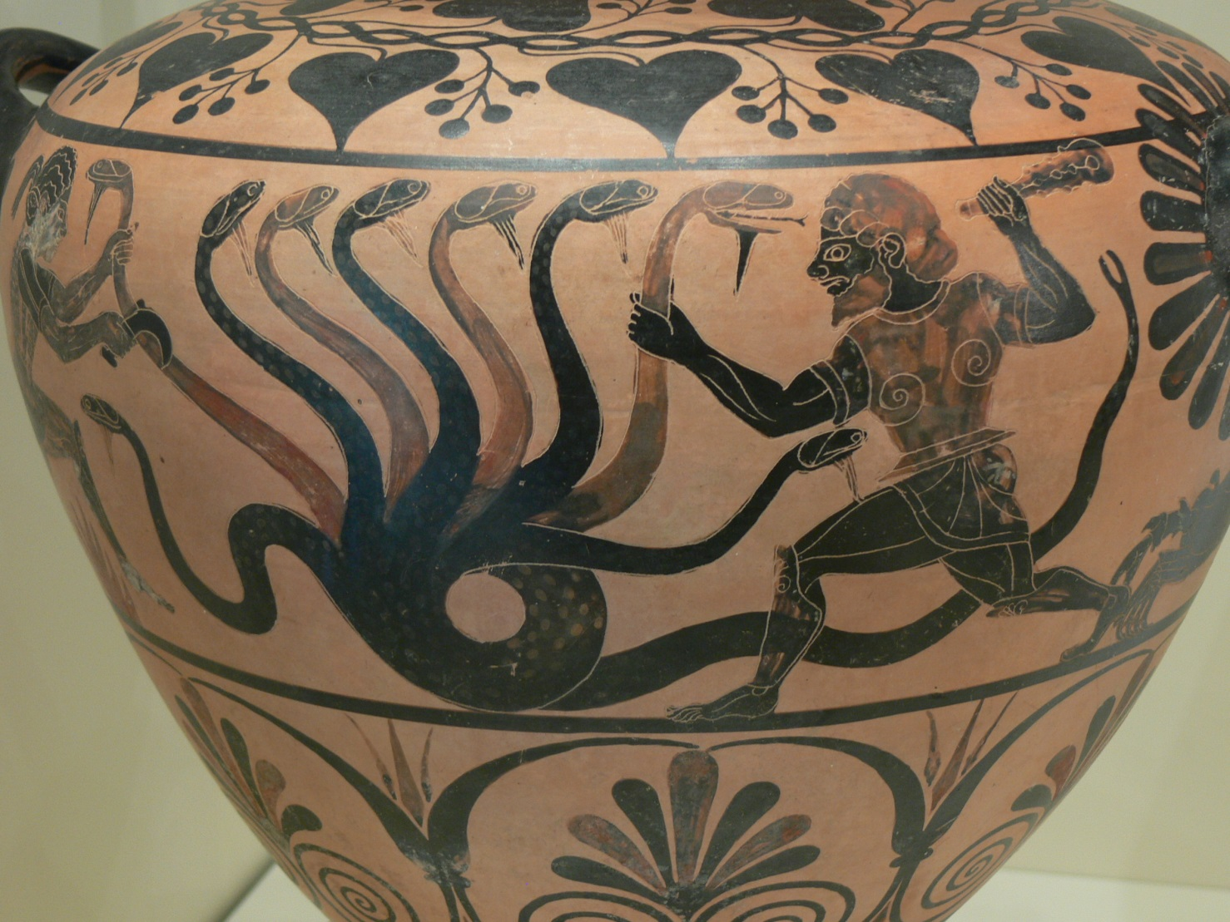
Challenges

Slide 49

Misuse!
The new features allow people to write incomprehensible code!!!
  So do old powerful features
“Every powerful new feature can and will be misused” – BS
  C’s for statement
  virtual functions
  templates
Get used to it
  Think
  Be careful
  Learn
Every feature/tool was new once

Slide 50
Pick the low-hanging fruit
Don’t write more complicated old-style code
  Avoid the “before examples”
Remove complicated old-style code from your code base
  Get “mechanical” help
You’ll find code that’s too messy to simplify “mechanically”
  Take the opportunity to fix bugs
Gain credibility before trying something really major
  Some of your favorite techniques/theories might not scale
  Don’t get fanatical
    Much old code works just fine
  Try not to be too clever

Slide 51
What if you are not allowed to use C++11/C++14?
Common reasons/rationales
  Antique coding standards
  Imaginary overheads
  Horrible large and messy code bases
  “Other programmers” assumed to be too dumb to use the simpler/newer solutions
  And the occasional annoying solid technical reason
    E.g., linking to code that’s not binary compatible with C++11/C++14
Find a way!
  Writing in antique styles implies costs
    makes maintenance more difficult
    Makes performance worse (sometimes, especially if you have to use older compilers/optimizers)
    Annoys good programmers

Slide 52
Design for a (more) ideal language
C++14 + TSs (if you don’t yet have that available)
C++17?
C++20?
Use libraries to simulate desired features
  Pattern matching anyone?
    www.stroustrup.com/OpenPatternMatching.pdf
Use “formalized comments’’
  int area(int h, int w)
  // precondition: h>0 && w>0
  template<typename T>
  // requires Sequence<T>() && Ordered<Value_type<T>>()

Slide 53
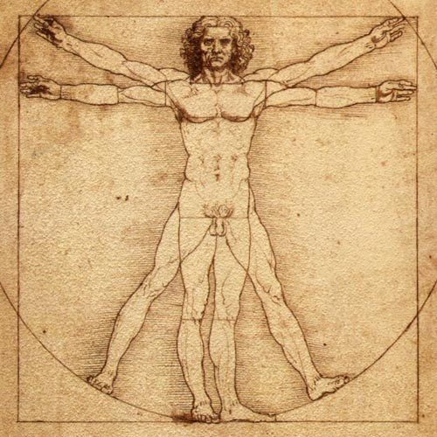
What next?
What should C++ be in 10 years?
  Think, think again, build, think again, experiment, think again, lobby
  Simplification is hard
  Simpler to use
  Type and resource safe
  Great specialized concurrency models, incl.
    Parallel
    Physically distributed
  Easier to distribute
  Easier to compose/link
  Faster
  More portable
  More libraries
  Better community

Slide 54
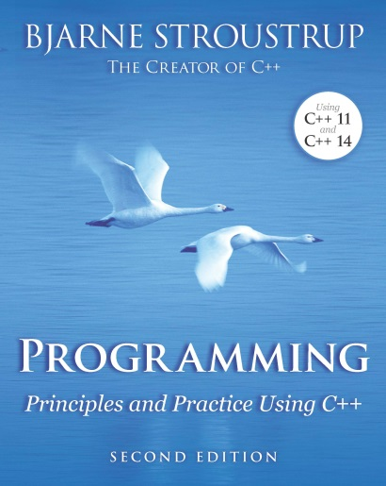
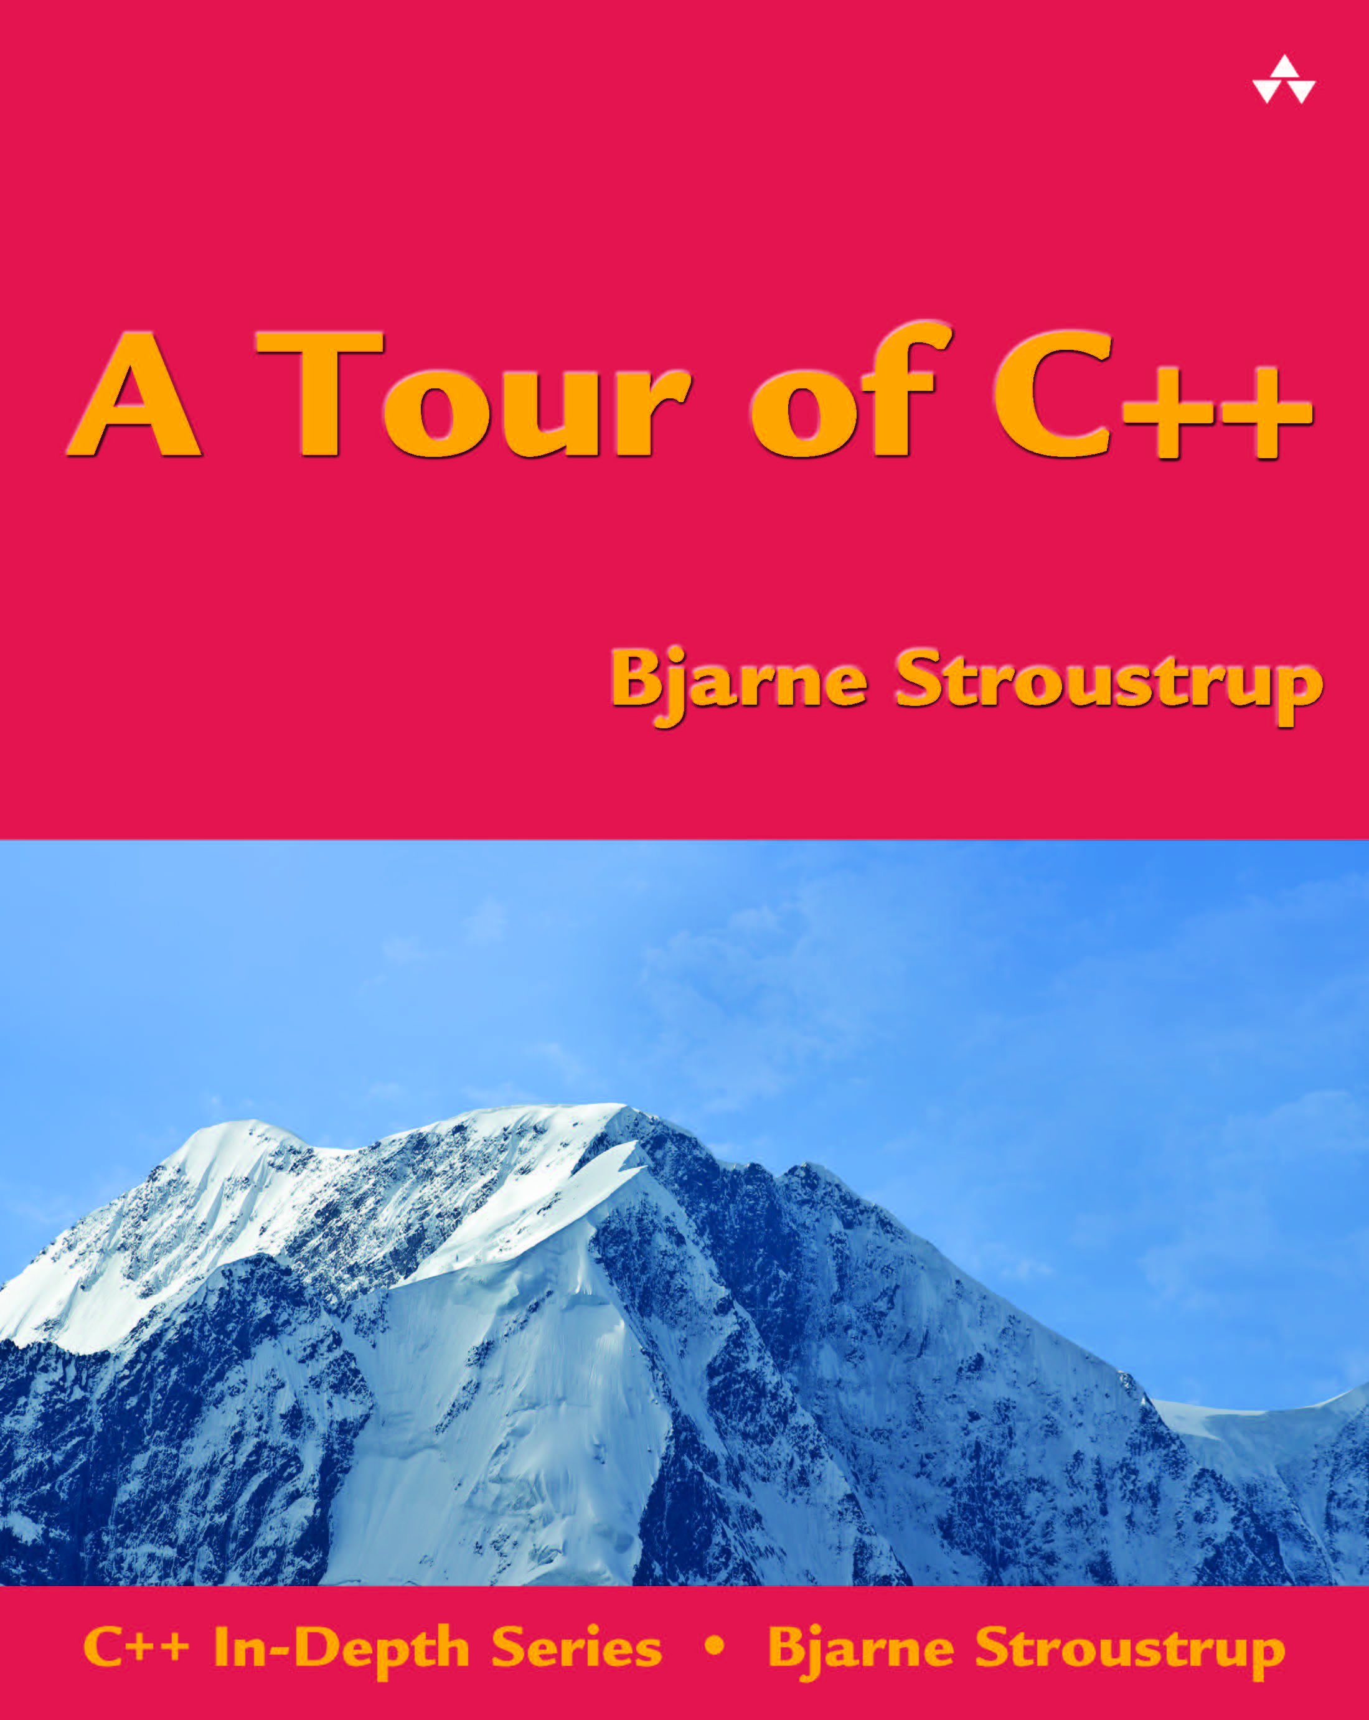
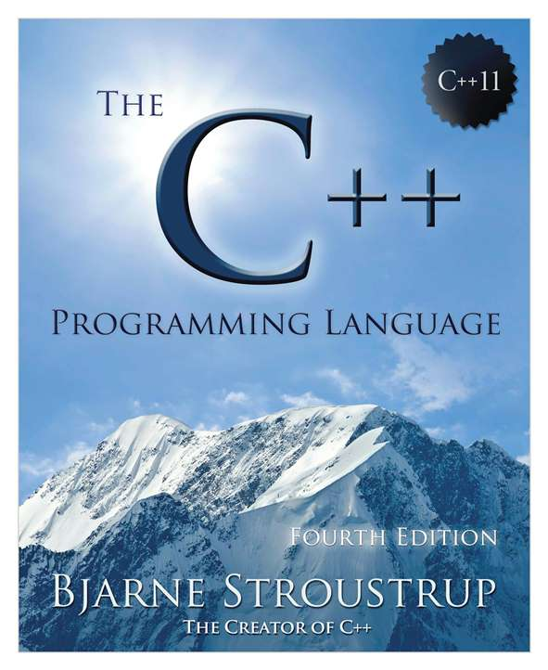
C++ Information
www.isocpp.org
  The C++ Foundation’s website
  Standards information, articles, user-group information
www.stroustrup.com
  Publication list, C++ libraries, FAQs, etc.
  A Tour of C++: All of C++ in 180 pages
  The C++ Programming Language (4th edition): All of C++ in 1,300 pages
  Programming: Principles and Practice using C++ (2nd edition)
www.open-std.org/jtc1/sc22/wg21/docs/papers
  The ISO Standards Committee site
  The ISO standard: All of C++ in 1,300 pages of “standardese”
  All committee documents (incl. proposals)

Slide 55


Questions?
C++: A language for programming with light-weight abstractions
Key strengths:
  software infrastructure
  resource-constrained applications
Practice type-rich programming
Keep simple things simple

Slide 56
Why is simplification useful?
We can write less code more easily
Why is simplification fundamentally important?
  A programming language is the way we express ideas
    The more clearly we can state our ideas the better
  The more clearly we state our intent, the more the compiler (and other tools) can help us
    Correctness
    Performance
  Our comprehension
  Teaching/learning

Slide 57


Slide 58
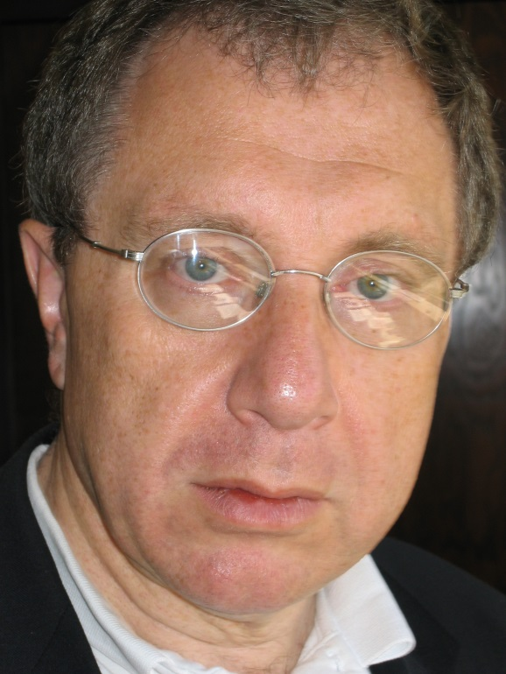
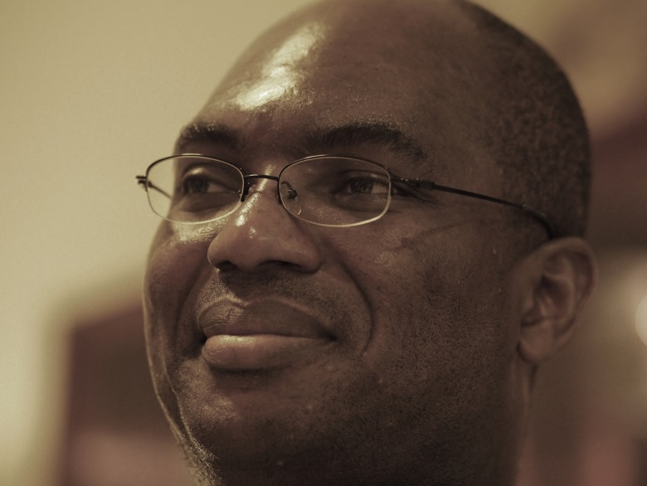
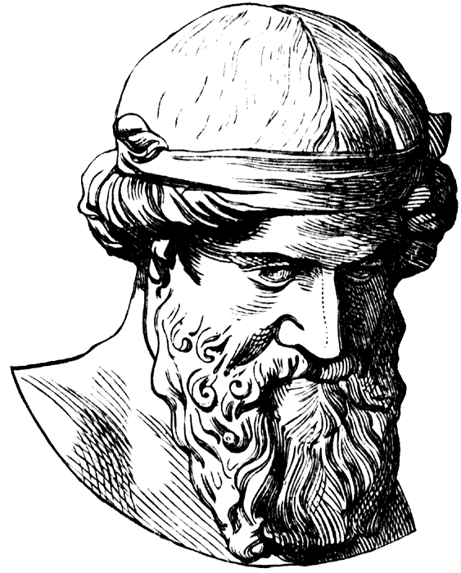
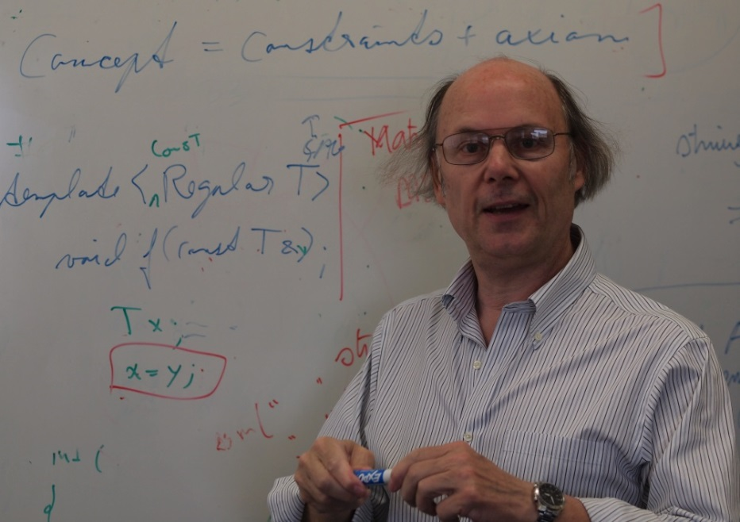

Concepts

Slide 59
Why language/library rather than tools?
State intent
  Don’t let a tool guess about it
The language is the programmer’s user interface
  Readability is crucial
  Don’t be unnecessarily verbose
    E.g. , m3 = m1*m2 vs. a nest of loops

Slide 60
Root cause (for good and bad)
Templates provide compile-time “duck typing”
  But duck typing is insufficient
    There are no proper interfaces
    Leaves error detection far too late
    Does not integrate well with other parts of the language
  We must think of generic code in ways similar to other code
    Relying on well-specified interfaces

